Slide 1

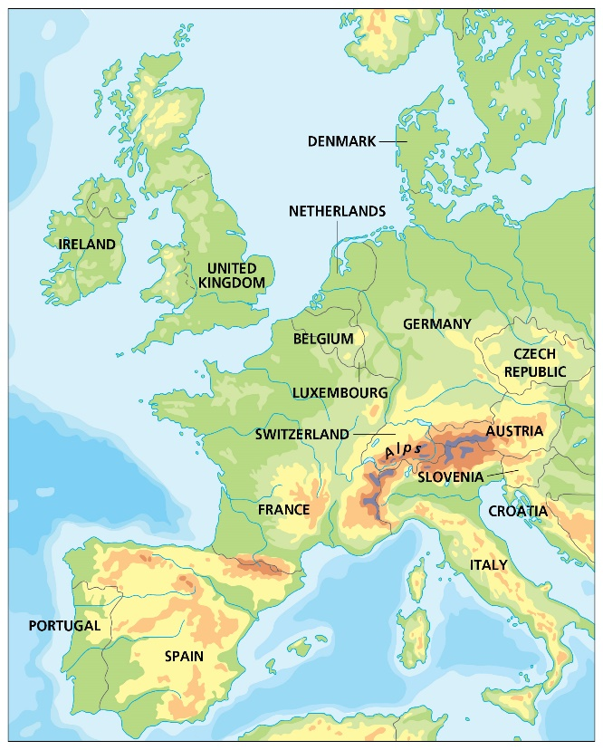
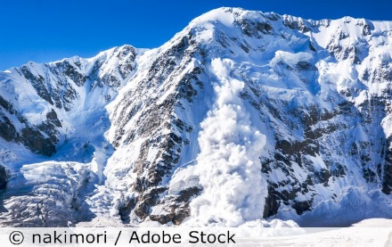
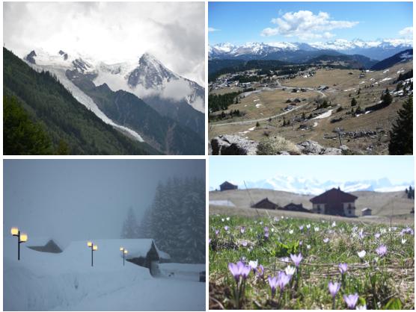
Geography – Europe a study of the Alpine region - Year 5 - Spring 1
Key Vocabulary and Definitions
1 |  | Climate – the average weather pattern of a place over many years, in the long term; climates can be predominantly hot, cold, wet or dry; and so on. The climate of a place affects the soil, flora and fauna of that place, and impacts on human activity in a variety of ways.
2 |  | Mountain – landform that rises high above the surrounding terrain in a limited area, made from rocks and earth. Generally described as higher and steeper than a hill.
3 |  | Region – an area that is defined by certain unifying characteristics, which may be physical, human or cultural
4 |  | Tourism – travelling for fun or holidays
5 |  | Wind – any horizontal movement of air, caused by pressure differences, which in turn are caused by temperature differences.
Key Facts
 | There are mountains in all countries of the UK, particularly in Scotland and Wales. The UK has a temperate climate, so we have a range of landscapes. The Alps also have a temperate climate at lower altitudes. The effect of this is prevailing winds carrying warm air belonging to the lower region unto an upper zone, where it expands and loses heat, and there is often precipitation in the form of snow or rain. In the Alps, the temperature can drop to -10ºC in winter and rise to 30ºC in summer. Homes must protect and insulate their inhabitants from extreme cold and heavy snowfall in winter. The Alps are one of the great European mountain ranges, and are spread across eight countries: France, Switzerland, Liechtenstein, Germany, Austria, Italy, Slovenia and Monaco. Mont Blanc spans the border of France and Italy and is the highest mountain in the Apls at 4810 metres. The Alps were formed over tens of millions of years as the African and Eurasian tectonic plates collided. More than 120 million tourists visit the Alps each year – tourism provides essential income. An avalanche occurs when a slab of snow, lying on top of a weaker layer of snow, fractures and slides down a steep slope.
What I need to know
● To describe key physical and human characteristics and environmental regions of Europe. ● To describe and understand a range of key physical processes and the resulting landscape features. ● To understand how a mountain region was formed. ● To know information about a region of Europe and its physical environment and climate, and economic activity. ● To be able to explain some ways biomes (including the oceans) are valuable, why they are under threat and how they can be protected. ● To understand how human activity is influenced by climate and weather. ● To understand hazards from physical environments and their management, such as avalanches in mountain regions.
What should I already know?
Use an atlas to locate the UK and some major urban areas Identify and name relevant continents

