Slide 1

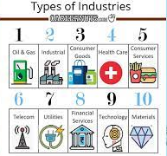
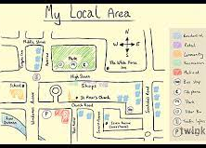
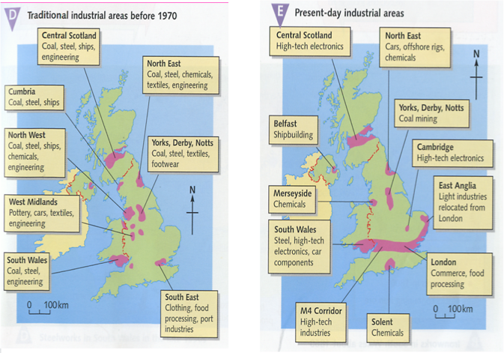
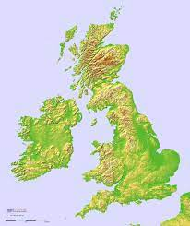
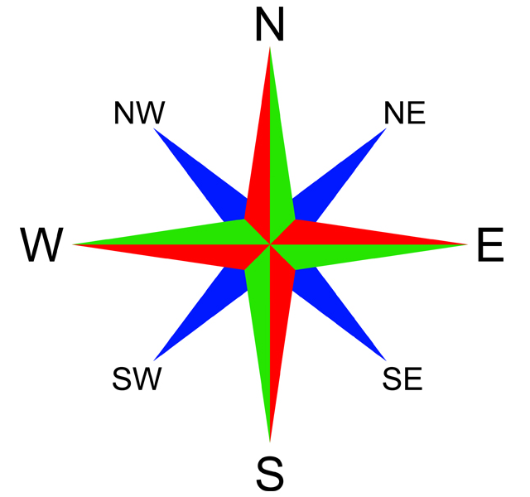
Geography: Changes in our Local Environment (Autumn 1) YEAR: 5
Vocabulary
1 | Human features | like houses, roads and bridges are things that have been built by people.
2 | Physical features | anything that is on the Earth naturally. Bodies of water – an area of land that is covered by water. Landforms – natural surfaces of the earth.
3 | Topographical features, | mountains, hills, valleys, lakes, oceans, rivers, cities, dams, and roads. Elevation - The elevation, or height, of mountains and other objects is recorded as part of topography.
4 | Environment | the surroundings or conditions in which a person, animal, or plant lives or operates.
5 | Grid reference | a map reference indicating a location in terms of a series of vertical and horizontal grid lines identified by numbers or letters.
6 | Compass | a tool for finding direction. The needle, which can spin freely, always points north
Key Knowledge
1 | To be able to identify and locate the geographical regions and key topographical features of the UK (including hills, mountains, coasts and rivers), and land-use patterns; and understand how some of these aspects have changed over time.
2 | To be able to locate the UK's major urban areas, knowing some of their distinct characteristics and how some of these have changed over time.
3 | To understand how a region has changed and how it is different from another region of the UK.
What should I already know?
The difference between human and physical geography.
That the area in which I live and other area of the UK have changed over time and due to different circumstances e.g. War, the need for new housing and transport links.
That grid references are used to locate places on a map.
How to use a compass and the 8 points of the compass.
That the area around where I live has changed over time and some idea of why that has happened, e.g redistribution of land due to Smart Motorways

