Slide 1

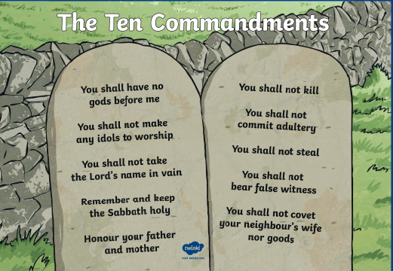
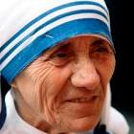
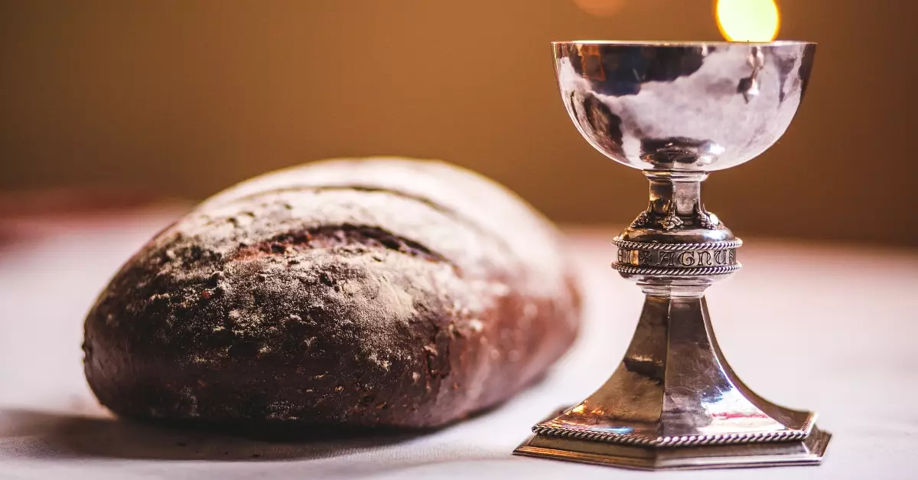
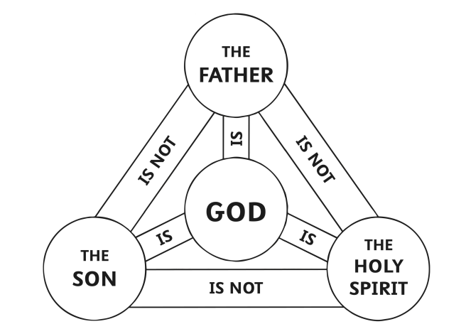
RE: Christianity –What is the best way for a Christian to show commitment to God?
(Summer 2) YEAR: 5
Vocabulary
1 | Commitment | A willingness to give your time and energy to a job, activity, or something that you believe in.
2 | Gifts of the Holy Spirit | The gifts are: wisdom, understanding, guidance, strength, knowledge, devotion and fear of the lord.
3 | The Lord’s Prayer | The prayer taught by Jesus to his disciples.
4 | Confirmation | Strengthening or deepening one’s commitment to God.
5 | Holy spirit | The third part of the Trinity; God as spiritually active in the world.
6 | Holy Communion | A Christian ceremony in which bread and wine are consumed in memory of Jesus.
What should I already know?
Praying helps followers feel closer to God.
The body and blood of Christ are represented by bread and wine (as told at the last supper)
Christians believe in living an honest life.
Christians sometimes go to Church to worship.
Key Knowledge
1 | Many Christians show commitment to God by attending church every Sunday and worshipping God
2 | The commandments help Christians live a good life.
3 | Christians believe that praying to God shows commitment.
4 | Some Christians show commitment through taking Holy Communion. It helps Christians to remember Jesus dying for them on the cross. By taking communion it shows their commitment to God.
5 | Some Christians have dedicated their lives to helping others in order to show their love and commitment to God, E.g: Mother Teresa.
6 | Many Christians will choose to be confirmed (received into the Church as an adult).
7 | In confirmation, a baptised person believes that they are receiving the gift of the Holy Spirit.
Key Questions
Are the ten commandments easy to follow?
What does ‘Love your neighbour as yourself mean?’
Why do Christians pray? Is it necessary to show commitment to God?
Why do Christians eat bread and drink wine? Does taking communion show commitment?

