Slide 1

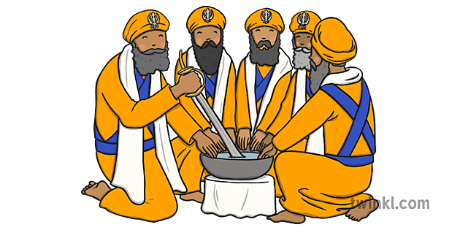
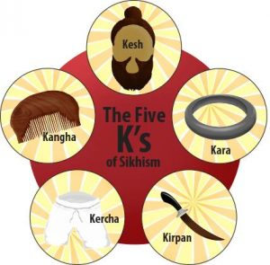

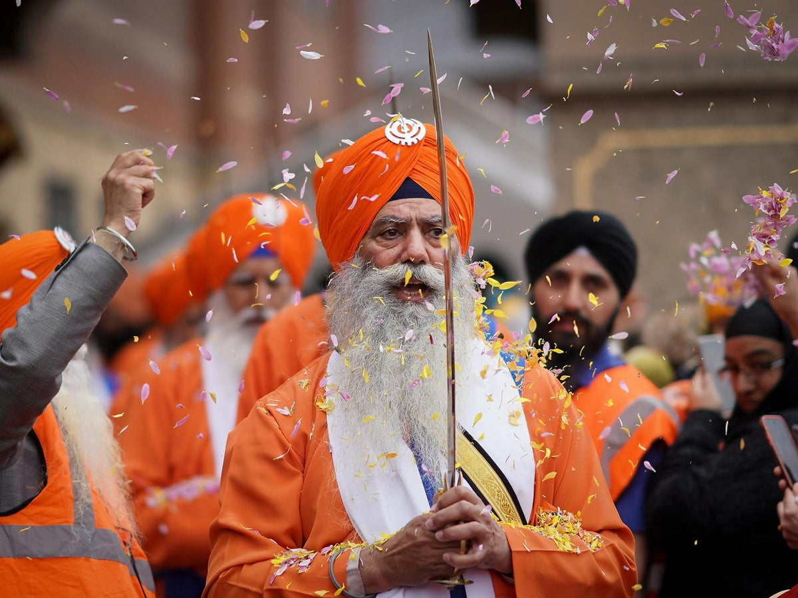
RE: Sikhism - What is the best way for a Sikh to show commitment to God?
(Summer 1) YEAR: 5
Vocabulary
1 | Guru | Means teacher. There were ten gurus who shaped Sikhism. Guru Nanak was the first Guru.
2 | Langar | The community kitchen in a Gurdwara where a free meal is served to all the visitors, without distinction of religion, gender, economic status or ethnicity.
3 | Amrit | Sweetened water that is drunk during the Amrit ceremony. It means nectar.
4 | Five Ks | Kangha - comb, Kirpan - sword, Kara - bracelet, Kachera - shorts, Kesh - uncut hair.
5 | Vaisakhi | Marks the Sikh new year and commemorates the formation of Khalsa panth of warriors under Guru Gobind Singh in 1699
6 | Khalsa | The word 'khalsa' means 'pure'.
What should I already know?
I know about the 5 K’s.
I know Sikh means ‘learner’ and ‘Guru’ means teacher.
I know there are 10 living Gurus, the 11th Guru is the Guru Granth Sahib.
I know Sikhs worship in the Gurdwara.
I know Sikhs believe everybody is equal.
I know that Sikhs who join the Khalsa show their full commitment to God.
I know what happens during an Amrit ceremony.
Key Knowledge
1 | The Guru Granth Sahib is the holy book, named after a living Guru. Sikhs believe that God is talking through the Guru Granth Sahib. It is treated with the upmost respect.
2 | A special ceremony called ‘taking Amrit’ is the way to become a Khalsa Sikh. Wearing the Five Ks is how many Sikhs show their commitment
3 | It is an important part of Sikh teaching that everyone is equal. God’s love is for everyone, so no one is better than anyone else. Men and women and people from different backgrounds should always be treated in the same way
4 | A gurdwara is a place of assembly and worship for Sikhs. Sikhs also refer to gurdwaras as Gurdwara Sahib. People from all faiths are welcomed in gurdwaras.
5 | Joining the Khalsa is a sign of commitment in Sikhism. Today, Sikhs who wish to become members of the Khalsa show their commitment and dedication by taking part in the Amrit Sanskar ceremony .
Key Questions
Is helping people a good way of Sikhs showing commitment to God?
How does the way the holy book is treated show commitment to God?
How does the Amrit ceremony compare to a Christian baptism/Christening?
Is it always easy to show commitment to God?

