Slide 1



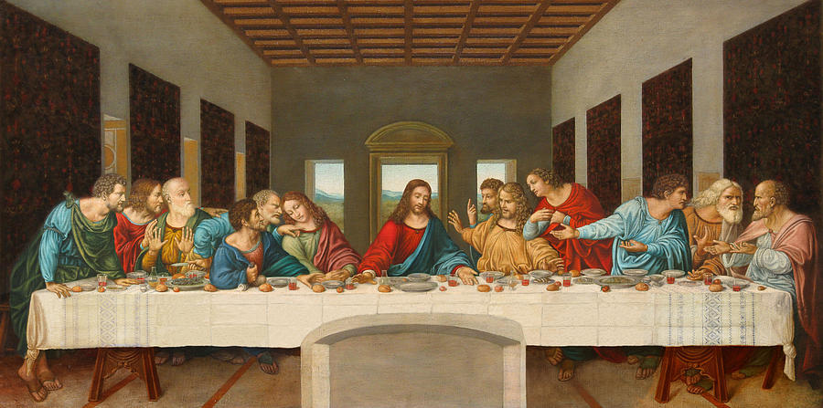
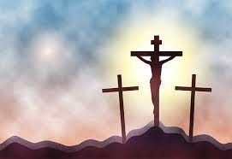
RE: Salvation - How significant is it for Christians to believe God intended Jesus to die?
(Spring 2) YEAR: 5
Vocabulary
1 | Salvation | being saved or rescued from harm, ruin or loss. Believed by Christians to be brought about by faith in Christ.
2 | Sacrifice | The act of giving up something that you want to keep. In Christianity, Jesus gave his life to save humankind from Sin.
3 | Resurrection | Christians believe that the resurrection proves that Jesus is the Christ (Messiah) and the Son of God.
4 | Saviour | (In Christianity) God or Jesus Christ as the redeemer of sin and saver of souls. Saviour - means 'anointed one’ in Hebrew
5 | Easter | Easter is the most important festival in the Christian calendar. It celebrates Jesus rising from the dead, three days after he was crucified.
6 | Forgiveness | Forgiveness (in Christianity) is defined as the letting go of sin.
7 | Baptism | Baptism is a ceremony that symbolises a commitment to living a life as a Christian.
8 | Sin | in or a sin is an action or type of behaviour which is believed to break the laws of God
9 | Incarnation | that God became human and became a man in the form of Jesus Christ,
What should I already know?
That Jesus died on the cross and was resurrected on Good Friday.
The cross represents Jesus’ death, wine – his blood and bread – his body.
Jesus died to save Christians from their sins.
What Christians believe about forgiveness.
Key Knowledge
1 | Christians believe the Bible points out the need for God to save his people.
2 | The New Testament says that Jesus’ death was ‘for us’. He made a sacrifice.
3 | The Gospels give accounts of Jesus’ death and resurrection.
4 | God intended Jesus to die to prove to Christians they could have ‘life after death.’
5 | Judas and Peter betrayed Jesus – this was announced at his The Last Supper.
6. | Adam and Eve committed the original sin.
7. | The events of Holy week up to Palm Sunday.

