Slide 1

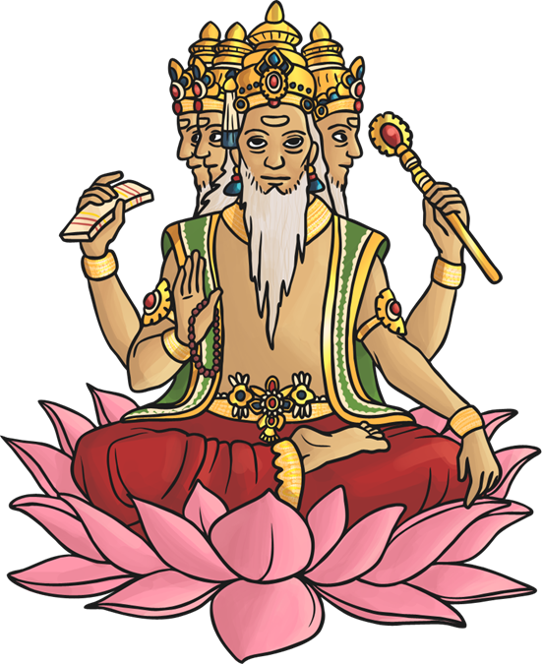
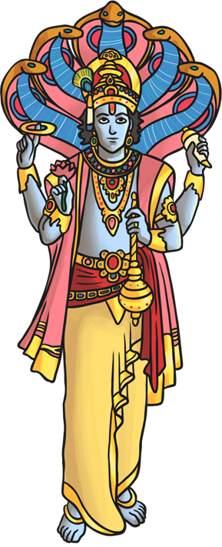
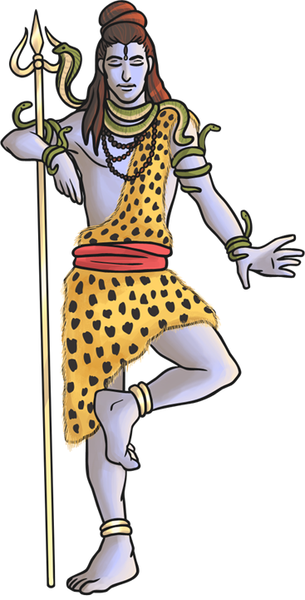
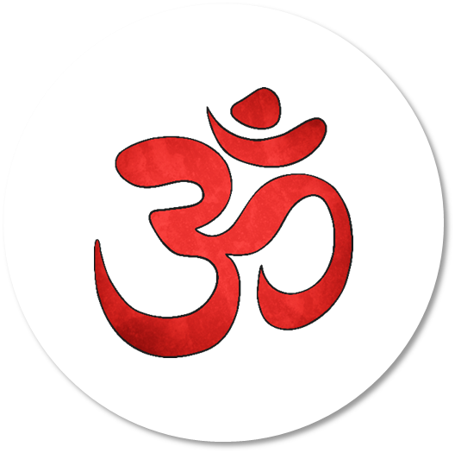
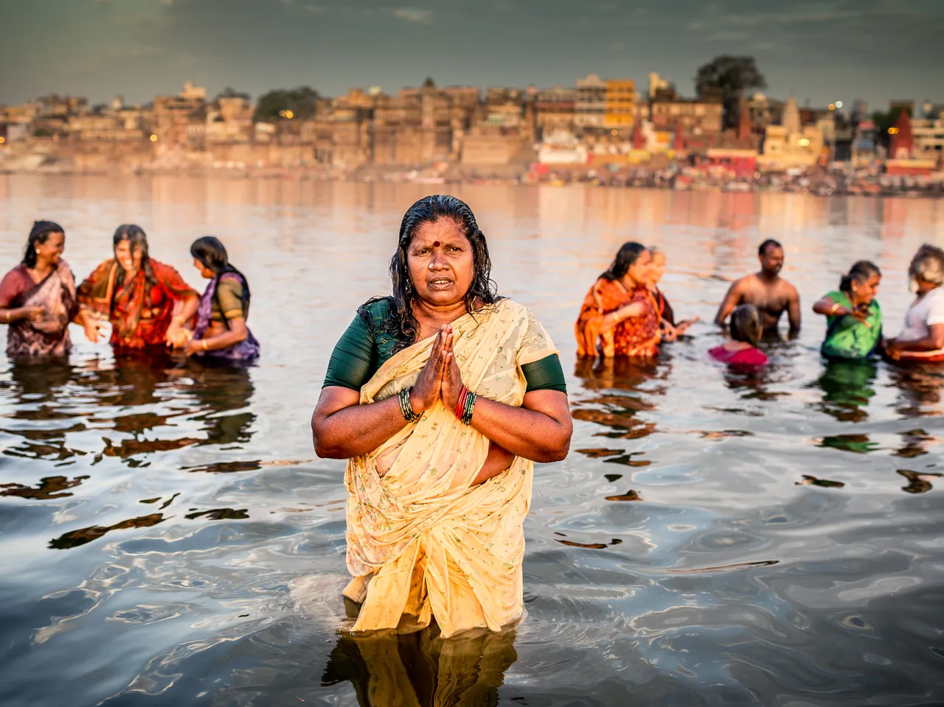
RE: Hinduism How can Brahman be everywhere and in everything? (Spring 1) YEAR: 5
Vocabulary
1 | Deity | A god or goddess
2 | Incarnation | A person who has the spirit of a deity within.
3 | Brahman | The spirit/core of everything and in everyone.
4 | Tri-Murti | The triad of the three gods Brahma, Vishnu, and Shiva.
5 | Atman | The real person (soul) inside an individual. It is made of part of the spirit of Brahman.
Key Knowledge
1 | Hinduism is the world's third most popular religion, with around 750 million followers.
2 | The religion of Hinduism originated in Northern India, near the river Indus, about 4000 years ago and is the world's oldest existing religion.
3 | Aum is the main symbol of Hinduism. It is the sound heard in deepest meditation and is said to be the name most suited for God.
4 | The word "Hindu" comes from the name of the river Indus, which flows 1800 mile
5 | The tri-murti are Brahma (Creator,) Vishnu (preserver) and Shiver (destroyer.)
6 | Stories found in Hindu scriptures offer guidance on how Hindu’s should live their own lives.
What should I already know?
I know Hindus believe the River Ganges is special and cleanses sins.
I know Hindus worship many Gods/Goddesses.

