Slide 1

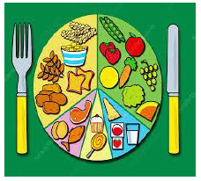
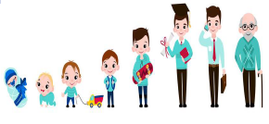

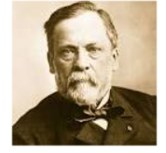
Science: Growing Up – Animal Life Cycles (Summer 2 ) YEAR: 2
Vocabulary
Adult | A fully grown animal or plant.
Develop | To grow and become stronger.
Life cycle | The changes living things go through to become an adult.
Offspring | The child of an animal.
Reproduce | When living things make a new living thing of the same kind.
Young | Offspring that has not reached adulthood.
Live young | Offspring that has not hatched from an egg.
Exercise | A physical activity to keep your body fit.
Heart rate | The number of times a heart beats in one minute.
What should I already know?
Animals, including humans have babies.
Babies grow into adults.
Key Facts
1 | Animals, including humans, have offspring which grow into adults.
2 | In humans and some animals, these offspring will be young, such as babies or kittens, that grow into adults. In other animals, such as chickens or insects, there may be eggs laid that hatch to young or other stages which then grow to adults.
3 | The young of some animals do not look like their parents e.g. tadpoles
4 | All animals, including humans, have the basic needs of feeding, drinking and breathing that must be satisfied in order to survive
5 | To grow into healthy adults, they also need the right amounts and types of food and exercise.
6 | Good hygiene is also important in preventing infections and illnesses.
Scientific enquiry & skills
Ask people questions and use secondary sources to find out about the life cycles of some animals.
Observe animals growing over a period of time e.g. chicks, caterpillars, a baby
Ask questions of a parent about how they look after their baby.
Ask pet owners questions about how they look after their pet
Explore the effect of exercise on their bodies
Classify food in a range of ways, including using the Eatwell Guide.
Famous Scientist: Louis Pasteur
Pasteur proved that germs can cause milk to sour or juice to become wine. He proved that germs can make people sick too.

