Slide 1

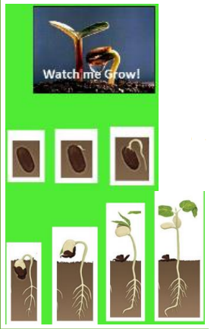
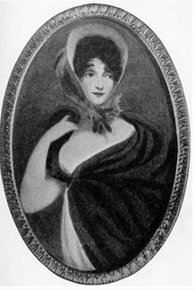
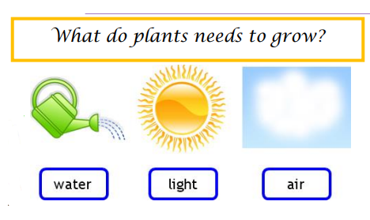
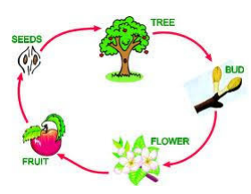
Plants (bulbs and seeds) (Summer 1) Year 2
Vocabulary
Seed | what plants grow from and how they reproduce
Bulb | A large food source that helps a plant to grow
Germination | The process in which the seed or bulb begins to grow into a plant
Growth | when the plant increases in size and grows taller
Survival | Living things have special features to help them to survive (stay alive) in their habitats.
Life Cycle | The different stages of life for a living thing.
Roots | absorb water and minerals from the soil.
Stem | supports the plant above the ground and carries the water to the leaves from the roots.
Leaves | the leaves collect food from the sun and make food for the plant
Disperse | To spread or scatter
Pollination | To fertilise by the transfer of plant pollen. The wind, birds and bees can pass pollens around.
What should I already know?
The different parts of a plant including leaves, flowers, fruit, seeds, roots, bulb, trunk, branches and stem.
Plants need light, water and soil which they use to make food.
Jane Colden
Jane Colden lived in America hundreds of years ago. She was born in the 1720s.
Scientists think that Jane was the first woman botanist in America.
Jane became very interested in the plants in her garden and in the area around her house. She started to sketch them and observed how they grew.
Jane worked with plants all her life. She died in 1766. Her work on plants is now displayed in the Natural History Museum in London.
How do plants disperse their seeds?
Animals: some get tangled in animal fur or feathers which then get carried to different places. Some get eaten by animals and digested and some get buried by animals like squirrels.
Wind: smaller seeds with wings or feather-like structures can be blown by the wind like a dandelion
Floating in water: many plants that live in or by water can often float and get carried by water. Even larger seeds like coconut can float!

