Slide 1

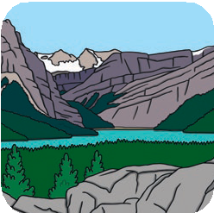
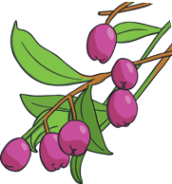
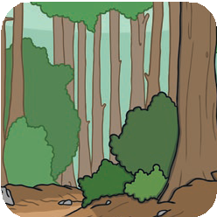
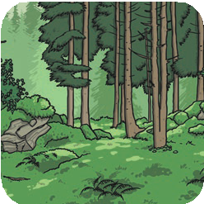
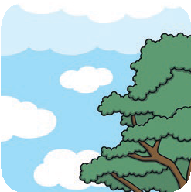
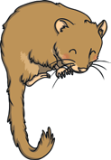
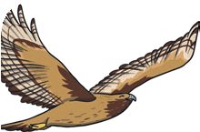
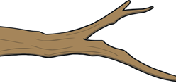
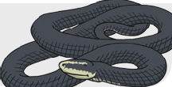
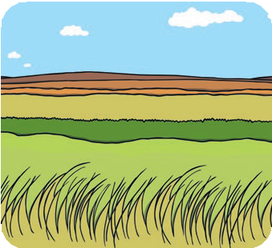
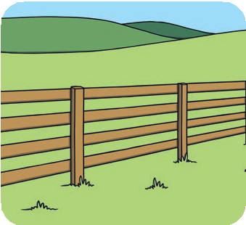
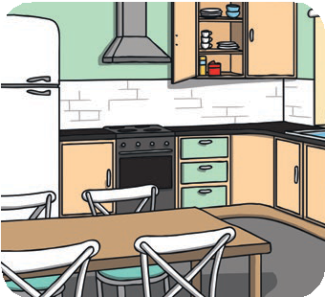
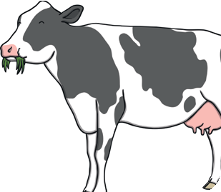
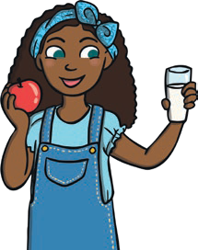
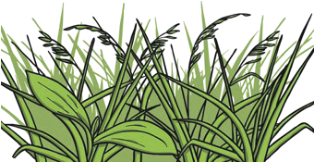
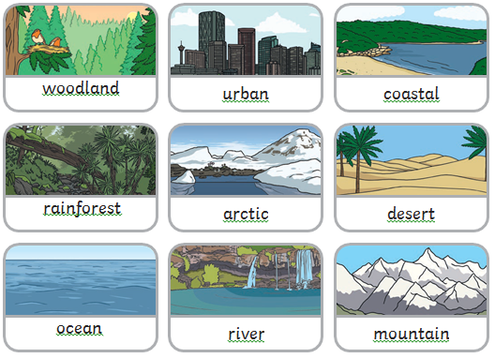
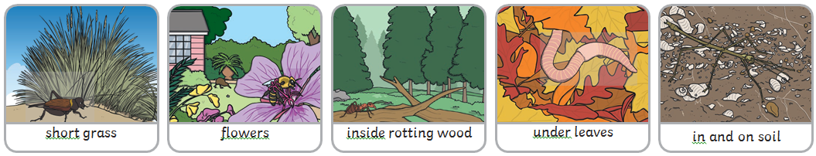
Habitats – Living things and their habitat (Spring 2) Year 2
Vocabulary
Life Processes | These are the things that all living things do. They move, breathe, sense, grow, make babies, get rid of waste and get their energy from food.
Habitat | A habitat is the natural place something lives. A habitat provides living things with everything they need to survive such as food, shelter and water.
Microhabitat | A microhabitat is a very small habitat in places like under a rock, under leaves or on a branch. Minibeasts live in microhabitats. The microhabitats have everything they need to survive.
Survive | This means to stay alive.
Food Sources | This is the place a living thing’s food comes from.
Food chain | The order in which energy is passed from one plant or animal to another when they are eaten
What should I already know?
The four seasons and the basic changes that take place in nature.
They know how humans and some animals can adapt.
The children know the life cycle of a penguin from our Cold Places topic and the changes that take place from Autumn to Winter.
They should know what a predator is and the role they play in a food chain.
Hibernate | To spend a long period of time in a deep sleep
Woodland | A large area with trees, shrubs and other plants
Arctic plants | Plants that grow in the Arctic
Desert | An area often covered in sand with very little rainfall
Food Chains
Living things are linked through their food. For example, a fox, a rabbit and a plat are linked because the rabbit eats the plant and the fox eats the rabbit. These links are called food chains.
The term food chain describes the order in which organisms, or living things, depend on each other for food.
A food chain shows how each living thing gets food, and how nutrients and energy are passed from creature to creature. Food chains begin with plant-life, and end with animal-life. Some animals eat plants, some animals eat other animals

