Slide 1

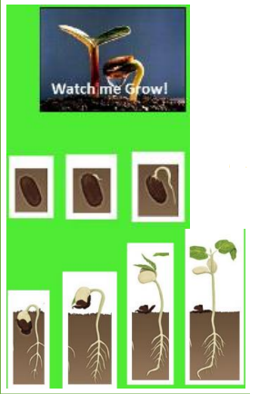
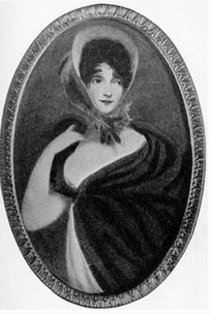
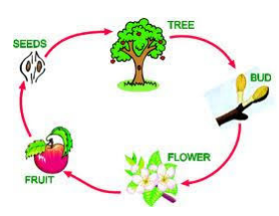
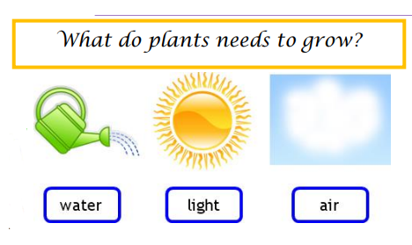
Plants – Light and dark (Spring 1) Year 2
Vocabulary
Plant | –a living thing that usually grows in soil
flower | the part of a plant that blooms
fruit | a part of a plant that contains seeds
vegetable | a part of a plant that can be eaten as food, such as a stem, root or leaf
herb | a plant that can be used to flavour food
blossom | the flowering part of a tree
branch | the part of a tree that grows from the trunk
leaf | the flat, green part of a plant that grows from the stem
stem | the long and thin part of a plant which sits above the soil
seed | a part of a plant that can grow into a new plant seed soil plant
Plant | p a living thing that usually grows in soil
What should I already know?
The different parts of a plant including leaves, flowers, fruit, seeds, roots, bulb, trunk, branches and stem.
Plants need light, water and soil which they use to make food.
Jane Colden
Jane Colden lived in America hundreds of years ago. She was born in the 1720s.
Scientists think that Jane was the first woman botanist in America.
Jane became very interested in the plants in her garden and in the area around her house. She started to sketch them and observed how they grew.
Jane worked with plants all her life. She died in 1766. Her work on plants is now displayed in the Natural History Museum in London.
Sunlight | the light from the Sun
Compost | a type of soil

