Slide 1

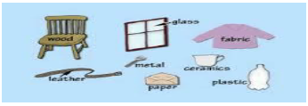
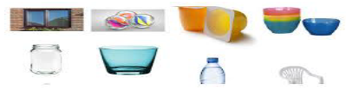
Science: Everyday Materials - Materials Matter (Autumn 2) YEAR: 2
Vocabulary
1 | Transparent | A material that is see-through, very clear
2 | Translucent | A material that will let some light pass through, but is unclear
3 | Opaque | A material that is not see-through and will not transmit light
4 | Flexible | It can be bent quite easily
5 | Absorbent | A material that will soak up liquid easily
6 | Waterproof | A material that will not let water through
7 | Reflective | A material which reflects, or redirects to the source
8 | Rigid | A material that is stiff, not easy to bend
What should I already know?
Name a variety of everyday materials.
Know the difference between the name of an object and the material which it is made.
Key Facts
1 | To explore the useful properties of materials with a range of investigations involving absorbency and flexibility. –To investigate which papers are the most absorbent.
2 | To investigate different fabrics and explore how waterproof they are using a dropper of water. How can we make the fabrics waterproof?
3 | To explore the textures and properties of different materials by printing with a selection of items. Make a large collective piece of art showing the variety of materials used by the class.
4 | Talk about how some materials change shape when they are heated up. Make a wax piece of art by applying wax to a piece of cotton and dying it.
5 | To investigate new materials made by John Dunlop and John McAdam.
Scientific enquiry & skills
To identify and compare the suitability of a variety of everyday materials for particular uses. For instance, something being waterproof. Can we make the fabrics waterproof?
Ask simple questions and recognise that they can be answered in different ways-Are all makes of paper as good as each other? How do we know? How can we find out?
Comparing the uses of everyday materials in and around school with materials found in other places.
Use observations and ideas to suggest answers to questions about the properties of the materials that they are working with.
Thinking about unusual and creative uses for everyday materials.

