Slide 1


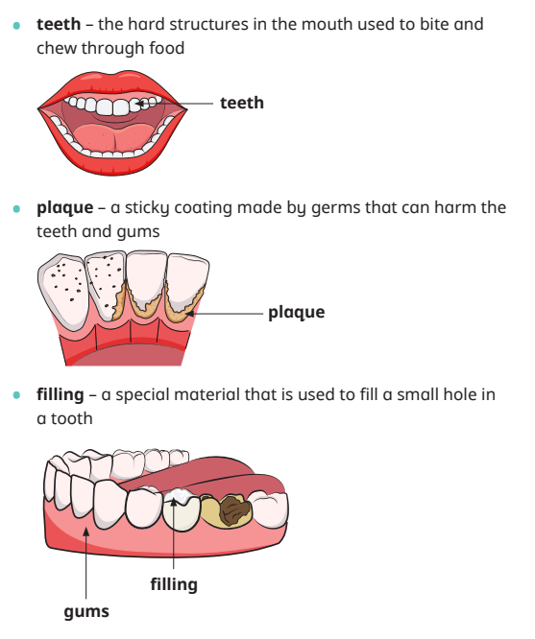
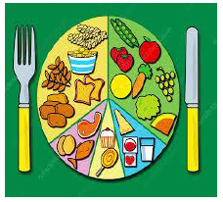

Science Knowledge Organiser – Year 2 – Autumn 1 - Animal needs for survival and Humans
Vocabulary
1 | Mammal | An animal with fur or hair on its body
2 | Scales | Small, hard layers that grow from the skin
3 | Reptiles | An animal with dry scales on its body
4 | Amphibians | The child of an animal.
5 | Omnivore | An animal that eats plants and other animals
6 | Herbivore | An animal that eats plants
7 | Carnivore | an animal that eats other animals
8 | Exercise | A physical activity to keep your body fit.
9 | Heart rate | The number of times a heart beats in one minute.
What should I already know?
 | Animals, including humans have babies.
 | Babies grow into adults.
Key Facts
1 | All mammals need air, water, food and shelter to survive. Mammals have fur or hair on their body. Mammals are carnivores, herbivores or omnivores
2 | Birds have feathers, wings and a beak. Birds need air, water, food and shelter to survive.
3 | Fish need air, water, food and shelter to survive. Fish have gills that they use to breathe.
4 | Amphibians live on land and in water. Amphibians do not have scales on their bodies. Some amphibians have webbed feet. Amphibians need air, water, food and shelter to survive.
5 | Reptiles have dry scales on their bodies. Reptiles need direct heat to survive.
6 | Exercise makes the heart work harder and is an essential part of a healthy lifestyle. Exercise improves physical and mental health.
7 | A healthy diet includes fruit, vegetables and other healthy food. An unhealthy diet is a diet that is high in fat, sugar or salt. It is important to eat the right amounts of different types of food.
8 | Germs can make you unwell. Germs are spread easily by unwashed hands. You should wash your hands, sneeze into a tissue and have regular baths or showers.
9 | You should brush your teeth twice a day with a toothbrush, toothpaste and water.
10 | Plaque can build up on your teeth and can damage your teeth and gums.
Scientific enquiry & skills
Ask questions about what things animals need for survival suggesting ways to find answers to their questions.
In Year 2, children should use the term “air” instead of oxygen, because they will not yet have been introduced to gases.
Plan questions thinking carefully about what information they want to gather and how to phrase the question accordingly.
Observe closely and record the effects of exercise, using simple equipment such as timers.
Children identify foods that can contribute to an unhealthy diet if consumed too often.

