Slide 1

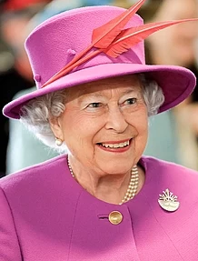
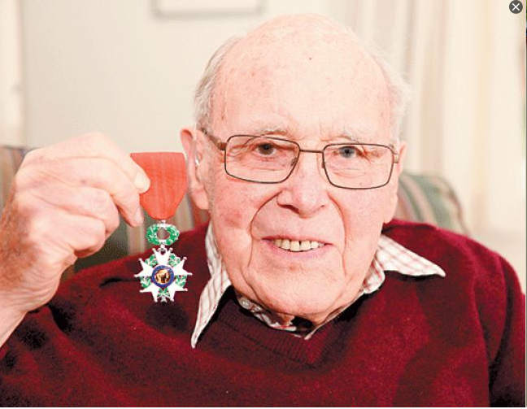
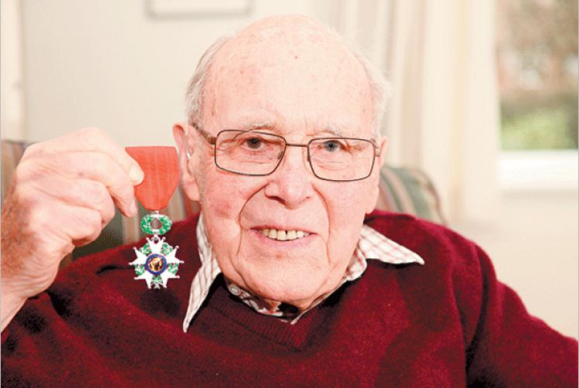
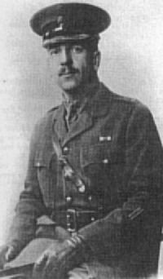
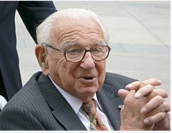
History: Our Local Heroes – Who are our local heroes? Year 2 (Summer 2)
Key Vocabulary
Portrait | a painting, drawing, photograph of a person, especially only of the face or head and shoulders
Significant | sufficiently great or important to be worthy of attention; noteworthy.
Local | Somewhere close by, in your area or neighbourhood.
Past | gone by in time and no longer existing.
Chronological | (of a record of events) following the order in which they happened.
Museum | a building in which objects of historical, scientific, artistic, or cultural interest are stored and exhibited.
Artefact | an object made by a human being, typically one of cultural or historical interest.
Exhibit | publicly display (a work of art or item of interest) in an art gallery or museum
Experts | person who is very knowledgeable about or skilful in a particular area
What should I already know?
Contributions people can make in order to become significant.
To use common words and phrases relating to the passing of time.
What do I need to know?
Children will know where the people they study fit within a chronological framework.
Children will study significant historical people and places in their own locality.
Children will understand some of the ways in which we find out about the past and identify different ways in which it is represented.
Queen Elizabeth II
Elizabeth II is Queen of the United Kingdom and 14 other Commonwealth realms. Elizabeth was born in London and lives in Windsor. She was educated privately at home. In November 1947, she married Philip Mountbatten
Mike Alston
Mike Alston, of Belmont Park Road, was awarded the Legion d’honneur for his role in the liberation of France in 1944 as part of ‘Operation Dragoon’. As a Royal Navy sailor, Mike served in one of the minesweepers leading invasion forces to French beaches.
Thomas Tannatt Pryce
A World War One memorial garden has opened in Maidenhead in honour of a soldier who was awarded the Victoria Cross for his bravery in France. Captain Thomas Tannatt Pryce of the Grenadier Guards was last seen on 13th April 1918 in a "fierce hand-to-hand struggle" at Vieux-Berquin.
Nicholas Winton
Sir Nicholas Winton MBE was a British humanitarian who helped to rescue children who were at risk of being Taken by Adolf Hitler and his Nazi Germany

