Slide 1

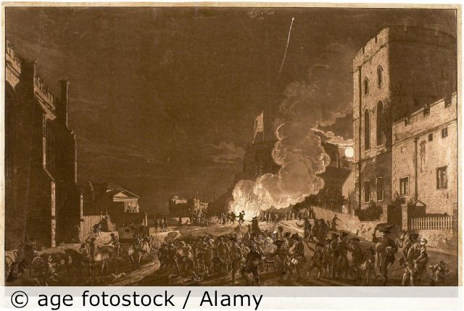
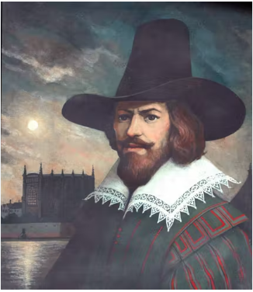
History: Bonfire Night and The Great Fire of London Year 2 (Autumn 2)
Key vocabulary
Guy Fawkes | A British soldier involved in a plan to attack Parliament and King James I.
Parliament | Parliament is the law-making group, in the United Kingdom.
King James I | King of England in 1605
Custom | Something that many people have done for a very long time.
Plot | A plan made in secret to do something illegal or harmful.
What I need to know
Bonfire Night is celebrated every year in Britain on 5 November.
It is an event to remember the Gunpowder Plot in 1605.
In 1605 most people in England were either Catholics or Protestants.
King James I was Protestant. Catholics were treated badly under him.
Guy Fawkes and 12 other men wanted to help the Catholics. They plotted to kill King James I by blowing up the Houses of Parliament.
The Gunpowder Plot failed. The next day (5 November) bonfires were lit to celebrate that the King had survived.
Some people thought that the plotters were villains for plotting to kill the King. Others thought that the plotters were heroes.
On 5 November in modern times, bonfires are lit and fireworks are let off. People spend time with friends and family and may eat traditional foods such as parkin and toffee apples.
Not everyone likes Bonfire Night. Some people think it is not safe and some people and animals really don't like the loud noises.
What should I already know?
Events happened in the past a long time ago
London is the capital city of the UK
Towns looked different in the past
This image from 1776 shows us people have been lighting fires for a long time.
Gunpowder Plot 1605
Living memory
1600
1700
1800
1900
2000
Guy Fawkes

Slide 2
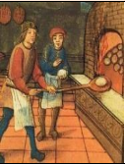
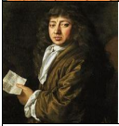
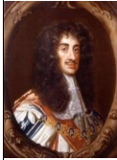
History: Bonfire Night and The Great Fire of London Year 2 (Autumn 2)
Key vocabulary
London | The capital city of England and the United Kingdom
River Thames | The river running through London
Diary | A personal record of life’s events
Eye-witness | A person who has seen something and can give a description of it
Embers | Small pieces of glowing coal or wood in a dying fire
Flammable | When something burns easily
St Paul’s Cathedral | A Christian building destroyed by the fire and rebuilt using designs by Sir Christopher Wren
Fire-hooks | Giant hooks used to pull down houses
Fire-break | When buildings are destroyed to make a gap so the fire can’t spread.
Historical skills & enquiry
Develop an awareness of the past, using common words and phrases relating to the passing of time
Choose and use parts of stories and other sources that they know and understand key features of events
What I need to know
When and where did the fire start? | The fire started in a bakery in Pudding Lane on 2nd September 1666.
Why did the fire spread? | There had been a long, hot summer so the city was very dry. Houses were built from wood, very close together. At first, people weren't allowed to use fire-hooks to create fire-breaks.
How did they fight the fire? | They used leather buckets and squirts filled with water, axes, fire-hooks and gunpowder to make fire-breaks.
How did the fire stop? | The fire burned for 4 days. As the wind died down and change direction the fire became under control and was finally put out.
How many people died? | 6 people died as a result of the fire. Thomas Farriner’s maid was the first person to die because she was too scared to jump from the burning building.
What happened after the fire? | 13,200 houses were destroyed by the fire and 70,000 people were left homeless. Many parts of the city were redesigned.
Key People
Thomas Farriner | A baker in 1666 London. Sparks from the oven in his bakery on Pudding Lane started the Great Fire of London.
Samuel Pepys | An MP and friend of King Charles II who became famous for his diary, which described the Plague and the Great Fire of London.
King Charles II | Charles II was the King of England in 1666.After the fire, he decreed that houses must be built further apart and built from stone not timber.
Great Fire of London 1666
Living memory
1600
1700
1800
1900
2000

