Slide 1


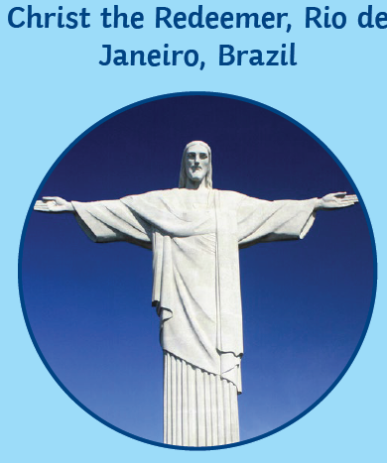
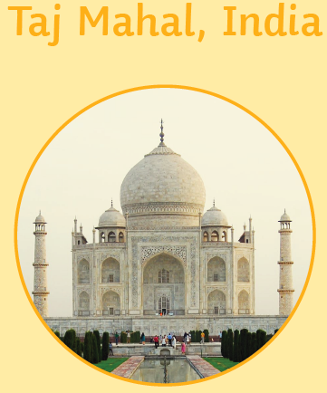
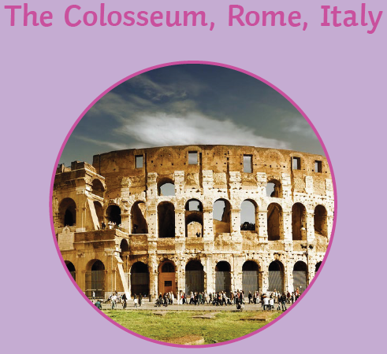
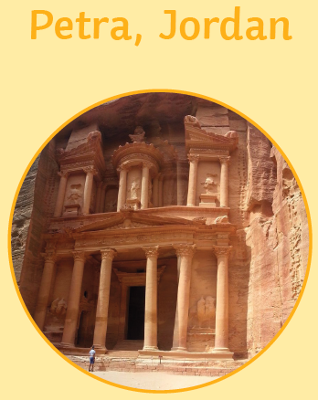
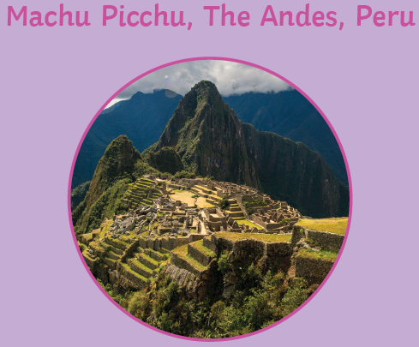
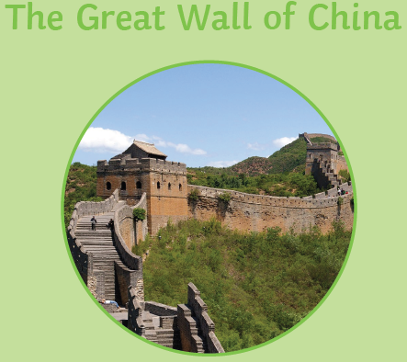
Geography: Our Wonderful World - Seven Wonders of the World - Year 2 (Summer 1)
Key Vocabulary
continent | A very large area of land that includes all the islands with it.
ocean | A large area of sea.
population | The number of people that live in a particular place.
landmark | A well-known building or place.
desert | A large area of land that has very little rainfall and where not much grows
rainforest | A large area of land with lots of tall trees and plenty of rainfall.
climate | The usual weather conditions of an area
equator | An imaginary line drawn around the middle of Earth, dividing it into the Northern and Southern Hemispheres
tropical | Hot and humid
capital city | An important city, often where the government works
currency | The money used in a country
cuisine | Traditional food of a country
What should I already know?
Where they live
The different continent and ocean names
The ‘layers’ and ‘areas’ of the world that lie between ‘here’ (local) and ‘there’ (beyond)
What do I need to know?
Name, locate and identify characteristics of the seven continents and oceans
Use world maps, atlases and globes Understand geographical similarities and differences when studying both human and physical geography
Identify the locations of hot and cold areas around the world
Use basic vocabulary to refer to physical and human features
Develop knowledge about the world.

Slide 2
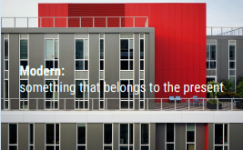
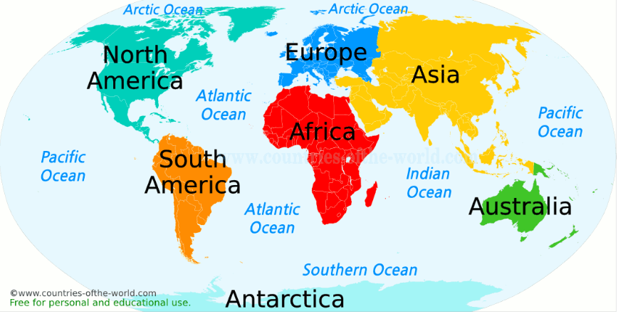
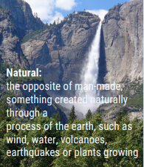
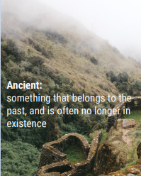

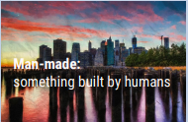
Geography: Our Wonderful World - Seven Wonders of the World - Year 2 (Summer 1)
Continents
There are seven continents: Africa, Antarctica, Asia, Australasia, Europe, North America and South America. Some continents have many countries, others do not.
World Oceans
There are five oceans in the world: the Arctic Ocean, the Atlantic Ocean, the Indian Ocean, the Pacific Ocean and the Southern Ocean.

