Slide 1

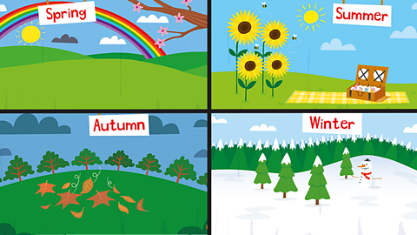
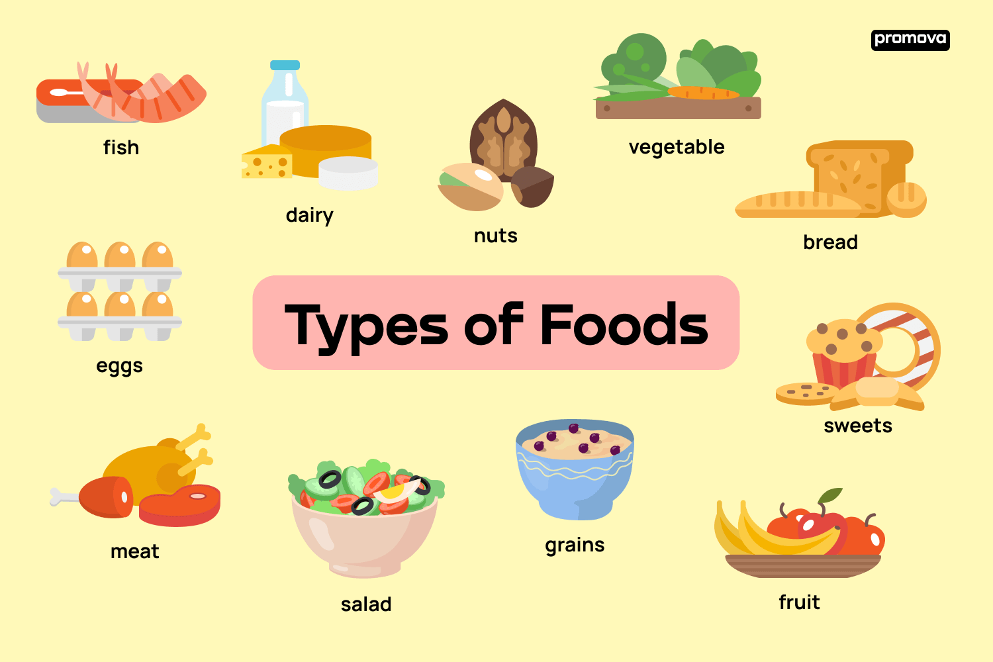
Where Does Our Food Come From? Geography – Year 2 (Spring 1)
Vocabulary
Food | Any substance that people or animals eat or drink to stay alive and healthy.
Farming | The activity of growing crops or raising animals for food, wool, or other products.
Harvest | The process of gathering mature crops from the fields when they are ready to be eaten or used.
Local | Relating to a particular area or neighbourhood, often used to describe food produced nearby.
Seasonal | Food that is grown or available during specific times of the year..
Produce | Fresh fruits, vegetables, and other items grown for food.
Supply | The amount of food available to be sold or consumed (eaten).
Vegetables | Edible plants or parts of plants, such as carrots, peas, or spinach..
Fruits | The sweet, edible part of a plant that contains seeds, such as apples, bananas, and strawberries.
Sustainability | Using resources, like food, in a way that does not harm the environment or deplete them for future generations..
Trade | Exchanging goods or services, such as food, between people or countries.
What should I already know?
Have a good understanding of your local area.
Be familiar with different types of foods, fruit, vegetables, meat and dairy).
Know the seasons of the year and that food can change depending on the season.

Slide 2
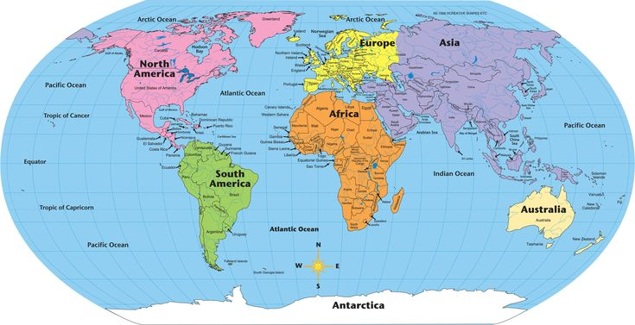
Where Does Our Food Come From? Geography – Year 2 (Spring 1)
Key Facts
Food comes from different places such as the sea (fish) and forests (nuts and berries).
Plants are grown for food through farming. This includes vegetables (like carrots and peas), fruits (like apples and bananas), and grains (like wheat and rice).
After food is grown or produced, it often travels long distances to get to markets and shops. This can involve packaging, transportation by trucks, ships, or planes, and storage.
Animals are raised for food, such as cows for beef, chickens for eggs and meat, and cows for milk.
Some foods are available only at certain times of the year because they grow in specific seasons, like strawberries in the summer and pumpkins in the autumn.
Some people are concerned about food waste and the importance of recycling packaging and using resources wisely.
What will I learn
food comes from different sources: plants (vegetables, fruits, grains) and animals (meat, dairy, eggs).
explore basic farming processes, such as planting, growing, and harvesting crops.
why some foods are seasonal and how weather and climate affect food production.
food may come from near or far, and this journey involves multiple steps to get it to the consumer.
how food is sold in local markets and shops and what happens to food when it is purchased by people.
the importance of eating a balanced diet and the different food groups (fruits, vegetables, grains, protein, dairy).
begin to understand how food production can impact the environment, including ideas like sustainable farming and reducing food waste.

