Slide 1

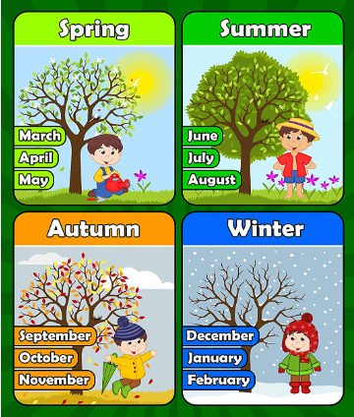
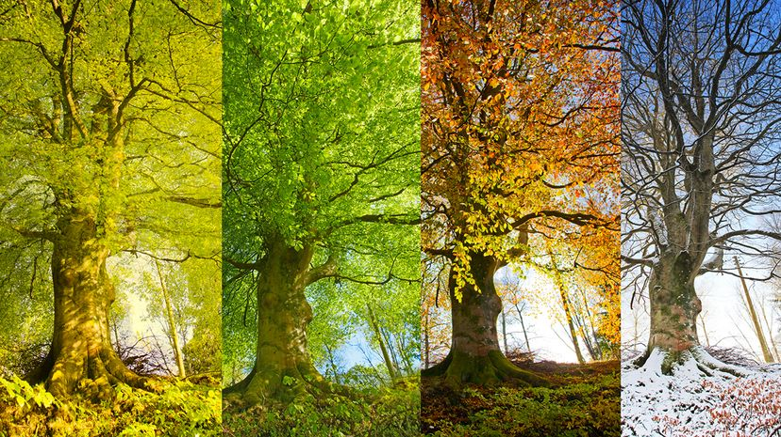
Geography: Seasons - Year 2 (Autumn 1)
Key Vocabulary
Season | The cycle of weather changes is divided into four parts, known as the seasons. The four seasons are winter, spring, summer, and autumn
Storm | A heavy fall of rain, snow, or sleet often with strong winds
Forecast | A prediction of something in the future a weather forecast.
Shadow | A shadow is created when an object is placed in front of a light source and prevents the light from passing through
Weather | Weather is the way the air and the atmosphere feels. It includes the outside temperature, strength of the wind, and whether it is raining, sunny, hailing, snowing, sleeting, foggy, or cloudy.
Thunder | The loud sound that happens after a flash of lightning when the air around it gets very hot.
Lightning | The flashing of light caused by the passing of electricity from one cloud to another or between a cloud and the earth.
Temperature | Temperature is how hot or cold something is.
Precipitation | The water that falls to the earth as hail, mist, rain, sleet, or snow.
What do I need to know?
To name and describe changes in the weather
To name the seasons and describe the basic UK seasonal weather patterns
To assist in taking repeated observations and record these using symbols
To understand the different parts of the UK, and that the weather may vary there
Knowledge, skills and concepts
To develop locational and place knowledge about their locality, and the UK as a whole
To understand basic subject-specific vocabulary relating to physical geography
To begin to use geographical skills, including first-hand observation, to enhance their locational awareness
To identify seasonal and daily weather patterns in the UK
To use simple fieldwork and observational skills in their school, its grounds and surroundings
To use and construct basic symbols in a key.
What should I already know?
Understanding of the concept of a day, week, month and year.
Understanding and description of the main changes across the seasons.
Understanding weather associated with the seasons.
Understanding how day length varies across the year.
Places in the east and south of the UK tend to be drier, warmer, sunnier and less windy than those further west and north

