Slide 1

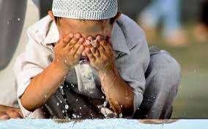
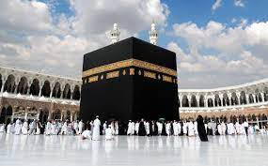
RE: Islam- Prayer at home (Spring 1 ) YEAR: 2
Key Vocabulary
Islam | Islam is the second most popular religion in the world.
Muslim | A follower of the religion of Islam.
Allah | The Arabic name that Muslims use for God.
Salah | The Islamic ritual prayer performed five times a day
Prayer | Communication with God (a feature of many religions)
Commitment | When you promise to do something and follow through with it, even if it gets hard.
Qur'an | The holy text for Muslims.
Ritual | A set of actions performed regularly with specific meaning
Five Pillars | Core beliefs of the Islamic faith
What should I already know?
Followers of Islam are known as Muslims.
Ramadan is a Muslim festival where Muslims fast during daylight hours and only eat after the sun has set.
Mosque - Muslim place of worship.
What will I learn?
Muslims believe that Salah (prayer) is one of the Five Pillars of Islam and the ritual should be performed five times a day: Fajr (pre-dawn), Dhuhr (midday), Asr (afternoon), Maghrib (sunset), and Isha (night)
Muslims will perform ablution (a ritual washing of the body) before each prayer.)
Muslims face the Kaaba in Mecca while performing Salah, when verses from the Qur'an are recited.
Performing Salah regularly is considered a way to set the pace of life for Muslims, helping to set orderly work and social patterns. Each of the five daily prayers is seen as having a specific function as part of the day.
Key Question:
Does praying at regular intervals everyday help a Muslim in his/her everyday life?

