Slide 1

SUBJECT : Science – Evolution and Inheritance (Summer 1) YEAR: 6
Vocabulary
1 | evolution | evolution the process by which different kinds of living organisms are believed to have developed from earlier forms during the history of the earth inherit derive
2 | inherit | derive (a quality, characteristic, or predisposition) genetically from one's parents or ancestors
3 | adaptation | the process of change by which an organism or species becomes better suited to its environment
4 | fossil | the remains or impression of a prehistoric plant or animal embedded in rock and preserved in petrified form
6 | organism | an individual animal, plant, or single-celled life form
7 | naturalist | an expert in or student of natural history
8 | geologist | the science which deals with the physical structure and substance of the earth, their history, and the processes which act on them
What Should I Already Know?
That individuals differ but may have inherited characteristics of parents. That animals have had to change over time in order to survive. That adaptation can take centuries to happen and leads to evolution. The terminology of evolution, inheritance and adaptation and its meaning. Who is Charles Darwin. What a fossil is.
What I Need To Know
What was Darwin’s theory of evolution? The theory of evolution by natural selection (first formulated in Darwin's book "On the Origin of Species" in 1859) is the process by which organisms change over time as a result of changes in inheritable physical or behavioural traits. What is inheritance? Inheritance refers to the characteristic traits that are genetically passed to offspring from their parents e.g. hair colour, eye colour, height etc. Darwin refers to this as natural selection when the strongest traits survive over generations. Fossils provide information about living things from the past How are fossils formed and what do they tell us about animals and plants that used to inhabit the earth? Fossils are the impressions of the remains of prehistoric animals or plants embedded in rock and preserved in petrified form. Living things have changed over time (adaptation) Animals change over time and adapt to the surroundings in which they live. Darwin observed that there were many forms of finches that had different beak sizes and shapes. Once he considered the food sources of each finch, he noted the reason for these adaptations. Adaptation, evolution and human intervention Consider: are all adaptations good? What is the impact of human intervention on evolution? What impact does this have on the wellbeing of the world and its inhabitants?

Slide 2
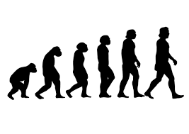
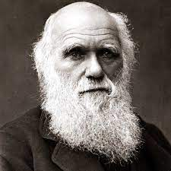
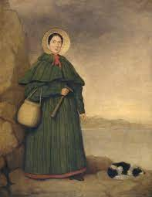
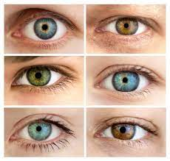
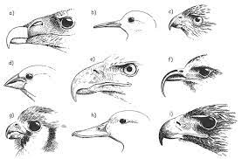
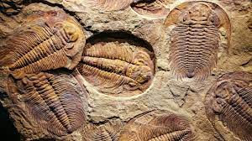
SUBJECT : Science – Evolution and Inheritance (Summer 1) YEAR: 6
Key Scientists
1 | Charles Darwin | Charles Robert Darwin (12 February 1809 – 19 April 1882) was an English born evolutionary biologist, naturalist and geologist who was best known for his contributions to the science of evolution. He first formulated his theory in his book "On the Origin of Species" in 1859.
2 | Mary Anning | Mary Anning (21 May 1799 – 9 March 1847) was an English fossil collector, dealer, and palaeontologist who became known around the world for important finds she made in Jurassic marine fossil beds in the cliffs along the English Channel at Lyme Regis in the county of Dorset in Southwest England.

