Slide 1

Science: Animals, including Humans (Spring 2) YEAR: 6
Vocabulary
1 | heart | The hollow, muscular organ that pumps blood through the body of a vertebrate animal by contracting and relaxing
2 | Pulse | a rhythmical throbbing of the arteries as blood is propelled through them, typically as felt in the wrists or neck
3 | Blood vessels | A tube through which the blood circulates in the body
4 | Oxygen | Oxygen is a colourless, odourless, tasteless gas essential to living organisms
5 | Carbon dioxide | It can be found as a gas in the air, or as a solid in the form of dry ice, which is very cold. Carbon dioxide is produced from breathing and from burning certain substances called fossil fuels.
6 | Nutrients | a substance that provides nourishment essential for the maintenance of life and for growth
7 | Circulatory system | the system that circulates blood and lymph through the body, consisting of the heart, blood vessels, blood, lymph, and the lymphatic vessels and glands
8 | Muscles | a band or bundle of fibrous tissue in a human or animal body that has the ability to contract, producing movement in or maintaining the position of parts of the body
9 | lifestyle | the way in which a person lives.
Key Knowledge
1 | The heart pumps blood in the blood vessels around to the lungs. Oxygen goes into the blood and carbon dioxide is removed. The blood goes back to the heart and is then pumped around the body.
2 | Nutrients, water and oxygen are transported in the blood to the muscles and other parts of the body where they are needed. As they are used, they produce carbon dioxide and other waste products.
3 | Carbon dioxide is carried by the blood back to the heart and then the cycle starts again as it is transported back to the lungs to be removed from the body. This is the human circulatory system.
4 | Diet, exercise, drugs and lifestyle have an impact on the way our bodies function. They can affect how well out heart and lungs work, how likely we are to suffer from conditions such as diabetes, how clearly we think, and generally how fit and well we feel.
5 | Some conditions are caused by deficiencies in our diet e.g. lack of vitamins.
What should I already know?
Describe the importance for humans of exercise, eating the right amounts of different types of food, and hygiene. (Y2 - Animals, including humans)
Identify that animals, including humans, need the right types and amount of nutrition, and that they cannot make their own food; they get nutrition from what they eat. (Y3 - Animals, including humans)
Describe the simple functions of the basic parts of the digestive system in humans. (Y4 - Animals, including humans)
Identify the different types of teeth in humans and their simple functions. (Y4 - Animals, including humans

Slide 2
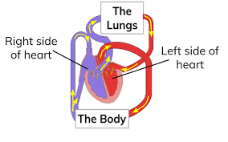
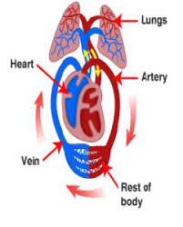
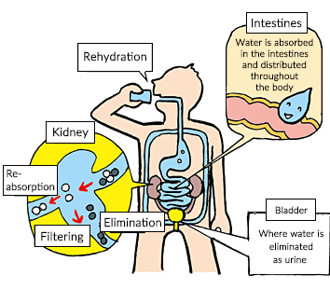
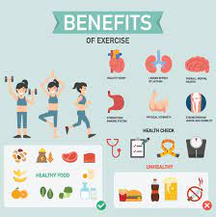
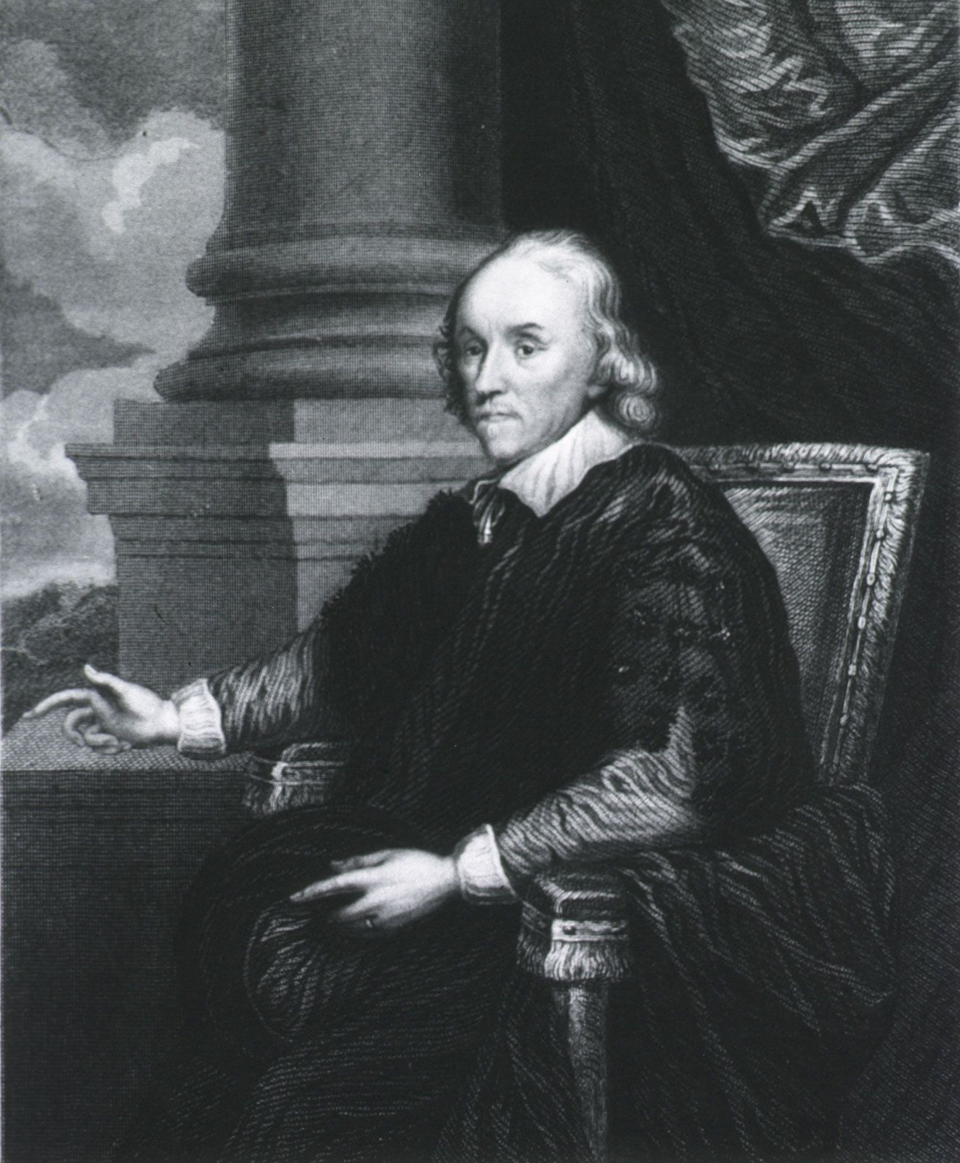
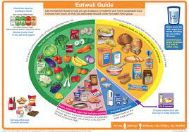
Common misconceptions
1 | your heart is on the left side of your chest
2 | the heart makes blood
3 | the blood travels in one loop from the heart to the lungs and around the body
4 | when we exercise, our heart beats faster to work the muscles more
5 | some blood in our bodies is blue and some blood is red
6 | we just eat food for energy
7 | All fat is bad for you
8 | all dairy is good for you
9 | protein is good for you, so you can eat as much as you want
10 | foods only contain fat if you can see it
11 | all drugs are bad for you
William Harvey, (born April 1, 1578, Folkestone, Kent, England—died June 3, 1657, London), English physician who was the first to recognize the full circulation of the blood in the human body and to provide experiments and arguments to support this idea.

