Slide 1

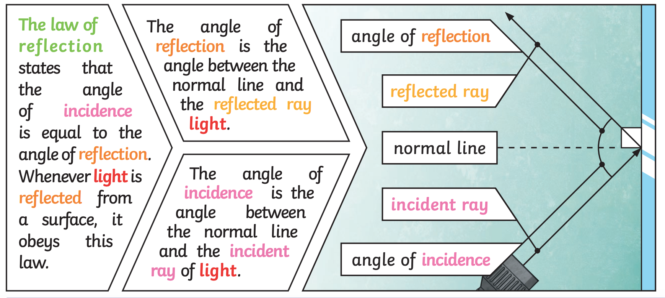
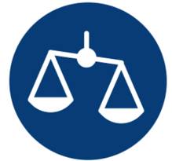
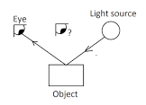



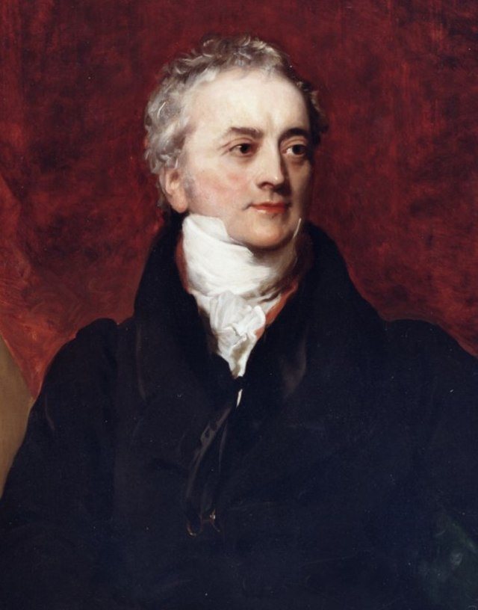
Science Knowledge Organiser – Light - Year 6 – Spring 1
Key Vocabulary and Definitions
1 | Light | A form of energy that travels in a wave from a source.
2 | Light source | An object that makes its own light.
3 | Reflection | Reflection is when light bounces off a surface, changing the direction of a ray of light.
4 | Incident ray | A ray of light that hits a surface.
5 | Reflected ray | A ray of light that has bounced back after hitting a surface.
6 | The law of reflection | The angle of the incident ray is equal to the angle of the reflected ray.
7 | Refraction | This is when light bends as it passes from one medium to another. E.g. Light bends when it moves from air into water.
8 | Visible spectrum | Light that is visible to the human eye. It is made up of a colour spectrum.
9 | Prism | A prism is a solid 3D shape with flat sides. The two ends are an equal shape and size. A transparent prism separates out visible light into all the colours of the spectrum.
10 | Shadow | An area of darkness where light has been blocked.
11 | Photon | Light is made up of photons, which are like tiny packets of energy. When an object's atoms heat up, photon are produced from the movement of atoms. The hotter the object, the more photons are produced.
12 | Translucent | Describes objects that things let some light through, but scatters the light so we can't see through them properly.
Key Facts
1 | Light appears to travel in straight lines, and we see objects when light from them goes into our eyes.
2 | The light may come directly from light sources, but for other objects some light must be reflected from the object into our eyes for the object to be seen.
3 | Objects that block light (are not fully transparent) will cause shadows. Because light travels in straight lines the shape of the shadow will be the same as the outline shape of the object.
4 | Light travels as a wave. Unlike waves of water or sound waves, it does not need a medium to travel through. This means light can travel through a vacuum - a completely airless space.
5 | Isaac Newton shone a light through a transparent prism, separating out light into the colours of the rainbow (red, orange, yellow, green, blue, indigo and violet) - the colours of the spectrum. All the colours together merge and make visible light.
6 | A spoon in this water looks as if it is bent. This is because light bends when it moves from air to water. When light bends in this way, it is called refraction.
7 | A shadow is always the same shape as the object that casts it. This is because when an opaque object is in the path of light travelling from a light source, it will block the light rays that hit it, while the rest of the light can continue travelling.
8 | Shadows can also be elongated or shortened depending on the angle of the light source. A shadow is also larger when the object is closer to the light source. This is because it blocks more of the light.
Diagrams/Pictures
Working Scientifically Skills
Comparative and fair testing
Pattern seeking
Identifying, grouping and classifying
Problem solving
Scientist
Thomas Young (1773 – 1829). Young is credited with establishing the wave theory of light, in contrast to the particle theory of Isaac Newton.
What should I already know?
Recognise that humans need light in order to see things and that dark is the absence of light. (Y3 - Light) Notice that light is reflected from surfaces. (Y3 - Light) Recognise that light from the sun can be dangerous and that there are ways to protect their eyes. (Y3 - Light) Recognise that shadows are formed when the light from a light source is blocked by an opaque object. (Y3 - Light) Find patterns in the way that the size of shadows change. (Y3 - Light)

