Slide 1

SUBJECT : Science – Living Things and Their Habitats (Autumn 1) YEAR: 6
Vocabulary
1 | microorganism | a microscopic organism, especially a bacterium, virus, or fungus.
2 | Classification | The systematic grouping of organisms according to the structural or evolutionary relationships among them
3 | Kingdom | the second highest taxonomic rank, just below domain. Kingdoms are divided into smaller groups called phyla. Taxonomy is a branch of science. It is about the laws and principles of classifying things.
4 | Phylum | Each kingdom has many smaller groups in it, called phyla. Each phylum has more smaller groups in it, called classes. This pattern looks like branches on a tree with smaller branches growing from them. Each species is put into a group because of what it does, how and what it eats, special body parts, and so on.
6 | Genus | a large group of different but closely related plants and animals
7 | Species | Species refers to a group of similar organisms that are able to reproduce.
8 | Linnaeus | Carolus Linnaeus was a Swedish naturalist. He created two scientific systems: the system for classifying plants and animals and the system for naming all living things.
9 | Why is classification important? | Classification means to group similar species together. There are millions of different species living on our planet - different types of plants, animals, fungi, and bacteria.. In order to learn more about them, it is necessary for scientists to sort them into groups
What should I already know?
That plants and animals are part of their own specifies and within that there are many other categories of classification. Children will have be taught that plants and animals both grow and require water. Unlike animals, plants use a process called photosynthesis. ... Plants reproduce by making seeds whereas animals lay eggs or give birth to their young. That there are different parts of a plant including leaves, flowers, fruit, seeds, roots, bulb, trunk, branches and stem and can name some common plants. Children will be able to identify and name common animals including fish, amphibians, reptiles, birds and mammals. Children are able to recall life cycles and habitats of some plants and animals.
What I Need To Know
To be able to describe how living things are classified into broad groups according to common observable characteristics and based on similarities and differences, including microorganisms, plants and animals. To be able to give reasons for classifying plants and animals based on specific characteristics. To learn about Linnaeus and learn about his classification system To create classification routes for a range of living things, identifying relatedness To group animals, micro-organisms and plants into broad groups then sub groups according to observable features To write scientific descriptions of unusual living things from around the world To classify unusual living things using their descriptions and online research

Slide 2
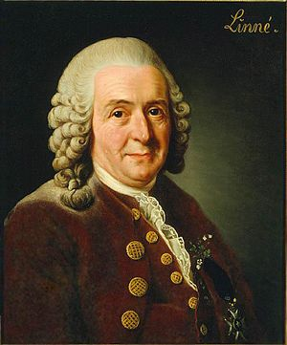
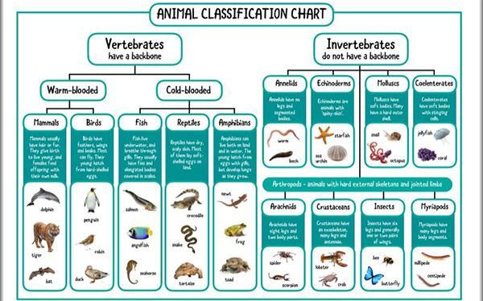
SUBJECT : Science – Living Things and Their Habitats (Autumn 1) YEAR: 6
Key Scientists
1 | Carolus Linnaeus | Carolus Linnaeus was a Swedish naturalist. He created two scientific systems: the system for classifying plants and animals and the system for naming all living things. Linnaeus is also called the Father of Systematic Botany.

