Slide 1

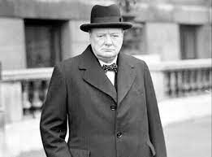
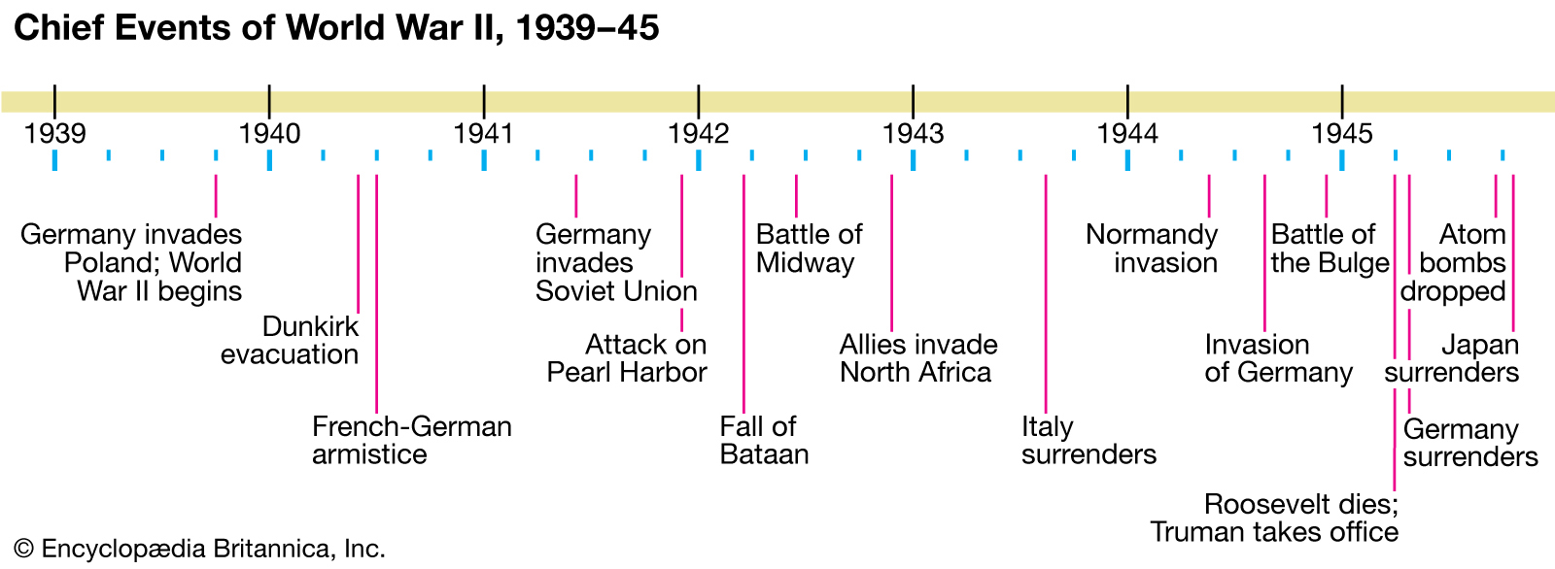
SUBJECT : History: World War II and The Battle of Britain ( Summer) YEAR: 6
Vocabulary WWII
1 | Phoney war | That no bombs or fighting took place for several weeks.
2 | Home Front | The 'home front' covers the activities of the civilians in a nation at war. ... Such drives helped strengthen civilian morale and support for the war effort.
3 | D-Day Landings | The Normandy landings were the landing operations and associated airborne operations on Tuesday, 6 June 1944 of the Allied invasion of Normandy in Operation Overlord during World War II. Codenamed Operation Neptune and often referred to as D-Day, it was the largest seaborne invasion in history.
4 | Operation Dynamo | The Dunkirk evacuation, codenamed Operation Dynamo and also known as the Miracle of Dunkirk, or just Dunkirk, was the evacuation of Allied soldiers during World War II from the beaches and harbour of Dunkirk, in the north of France, between 26 May and 4 June 1940
6 | Churchill | Prime minister (1940–45) during most of World War II,
7 | The Blitz | The Blitz was a German bombing campaign against the United Kingdom in 1940 and 1941, during the Second World War.
8 | Evacuee | People especially children, from the risks associated with aerial bombing of cities by moving them to areas thought to be less at risk.
What Should I Already Know?
The reasons for WWI, the main powers involved in WWI, the outcomes and effects on peoples lives.
Winston Churchill
Churchill is best remembered for successfully leading Britain through World War Two. He was famous for his inspiring speeches, and for his refusal to give in, even when things were going badly. Many people consider him the greatest Briton of all time and he's almost certainly the most famous British prime minister
What I Need To Know
What events led to WWI and how Hitler's campaign stretched across Europe
The impact of War on Europe and life afterwards
How and why Hitler invaded Europe, who were the allies and enemies
Timeline

Slide 2
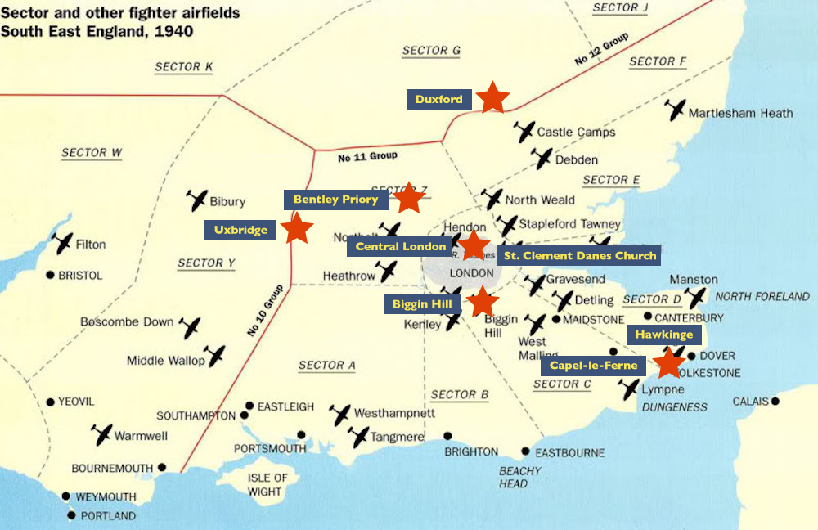
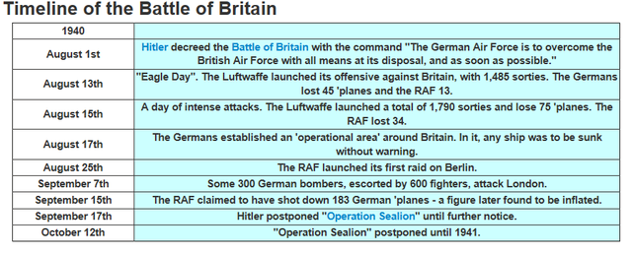
SUBJECT : History: WWII and The Battle of Britain ( Autumn 2) YEAR: 6
Vocabulary The Battle of Britain
1 | The Battle of Britain | a military campaign of the Second World War, in which the Royal Air Force and the Fleet Air Arm of the Royal Navy defended the United Kingdom against large-scale attacks by Nazi Germany's air force, the Luftwaffe. started on July 10th, 1940. It lasted many months as the Germans continued to bomb Britain. The name comes from a speech by the Prime Minister of Great Britain, Winston Churchill. After Germany had overrun France, he said that "the Battle of France is over. The Battle of Britain is about to begin”
2 | Luftwaffe | The German air force
3 | Radar | a detection system that uses radio waves to determine the distance, angle, or velocity of objects.
4 | RAF | Royal Air Force UK
5 | Operation Sea Lion | The code name for Hitler's invasion plans was Operation Sea Lion.
What Should I Already Know?
Dates of WWI and the reasons for it. Evacuees were part of WWII What life was life in the trenches of WWI Almost all the battles of World War I were fought in Europe and the Middle East. The two sides fighting each other were known as the Allies and the Central Powers. Men went to battle and women took their jobs to support the war effort.
What I Need To Know
Understand why WWII started Develop an understanding of who Churchill was and his significance as a leader Learn about the Home Front, evacuees and such terms as “Make do and mend” D-Day landings and Operation Dynamo
Timeline

