Slide 1

SUBJECT : History: Mayan Civilisation ( Autumn 2) YEAR: 6
Vocabulary
1 | Mesoamerica | a historical region and cultural area in southern North America and most of Central America
2 | Dynasty | A series of rulers or leaders who are all from the same family, or a period when a country is ruled by them.
3 | Maya | the name to the people of that time in Central America
4 | Mayan | the language spoken by the Maya people
6 | Maize | a grain that made up 80% of the Maya diet
7 | Hieroglyphs | symbols or pictures used to represent words
8 | Vigesimal | the number system based on 20s used by the Maya people
9 | Artefact | An object that is made by a person, such as a tool or a decoration, especially one that is of historical interest.
10 | Temple | A building used for the worship of a god or gods in some religions.
What Should I Already Know?
The location of Central America on a world map. That hieroglyphs were also used by the Ancient Egyptians. There have been many other civilisations in the world and many have co-existed in different parts of the world at the same time. For thousands of years all civilisation have had some sort of writing – hieroglyphs in the case of the Maya. The influence Maya civilisation has had on the calendar and maths They should understand how our knowledge of the past is constructed from a range of sources.
What I Need To Know
The development of the Maya civilisation To enquire when the Maya are first recognised by archaeologists and when this society is said to have come to an end, recognising that there are still living Maya people today. How the Mayans used logograms and hieroglyphs. Find out how the writing was used Discover the Copan stairway and its hieroglyphs and marvel at the four main Maya codices Discover the fascinating maths and calendar systems of the Maya. Learn about the Maya numerals, their maths system and the Dresden Codex. Represent Maya numbers; consider the Maya calendar and compare it to our own system. Study the buildings of this very early civilisation Look at how the Maya transport goods and what did they trade? Discover their impressive expertise, the logistics and the daunting geography that they had to overcome. Explore the methods of farming practised by the Maya and some of the foods they farmed, hunted and gathered

Slide 2
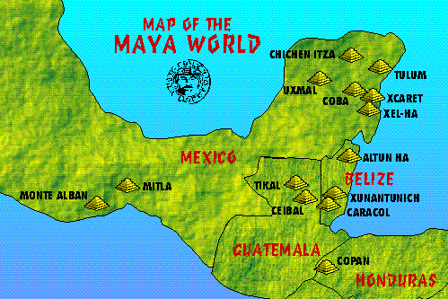
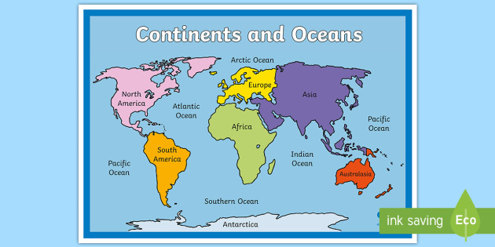
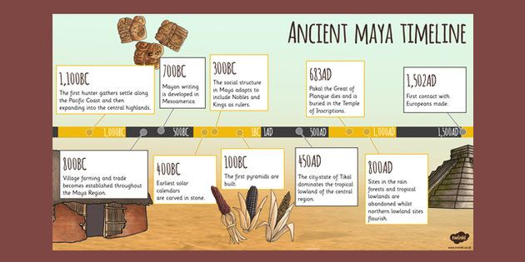
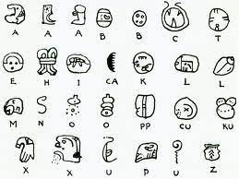
SUBJECT : History: Mayan Civilisation YEAR: 6
Top facts
1.The Mayans predicated that the world would end in 2012. 2. Flat foreheads were fashionable so they would put baby’s heads in a press to squash them. 3. It was considered beautiful to be cross-eyed so parents would hang balls in-between their children’s eyes to make them look inwards. 4. Mayans sacrificed humans for religious and medical reasons. It was an honour to be sacrificed! 5. Noblewomen would file their teeth into sharp points.
Timeline

