Slide 1

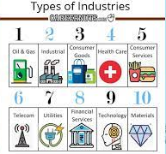
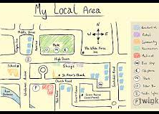
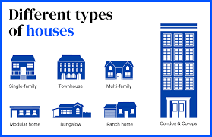
Geography: Our World in the Future (Summer 1) YEAR: 6
Vocabulary
1 | Human features | like houses, roads and bridges are things that have been built by people.
2 | Physical features | anything that is on the Earth naturally. Bodies of water – an area of land that is covered by water. Landforms – natural surfaces of the earth.
3 | Topographical features, | mountains, hills, valleys, lakes, oceans, rivers, cities, dams, and roads. Elevation - The elevation, or height, of mountains and other objects is recorded as part of topography.
4 | Region | an area of land that has common features
5 | Housing | What is called housing? Housing, or more generally living spaces, refers to the construction and assigned usage of houses or buildings collectively, for the purpose of sheltering people
6 | Industry | economic activity concerned with the processing of raw materials and manufacture of goods in factories
7 | Amenities | a desirable or useful feature or facility of a building or place, e.g. parking
8 | Community Spirit | a feeling of involvement in and concern for one's local community.
9 | Sustainable development | economic development that is conducted without depletion of natural resources
Key Knowledge
1 | Explain how, and offer reasons why, the types of industry in your local the area have changed over time and why your local area is special.
2 | Understand how human activity is influenced by climate and weather
3 | Understand that no one type of energy production will provide all our energy needs.
4 | Use digital maps to research factual information about features. Make sketch maps of areas using symbols, a key and a scale, listing local public services and industries and their locations.
5 | Plan and carry out fieldwork, presenting information gathered using a range of graphs and other data presentation techniques.
What should I already know?
How to plan, conduct and analyse fieldwork.
A range of industries and businesses in my local area.
A range of amenities in my local area
A degree of knowledge about what is available in the community for the purpose of community spirit.
A range of public services in my local area, e.g. buses, doctors, dentists, councils

