Slide 1

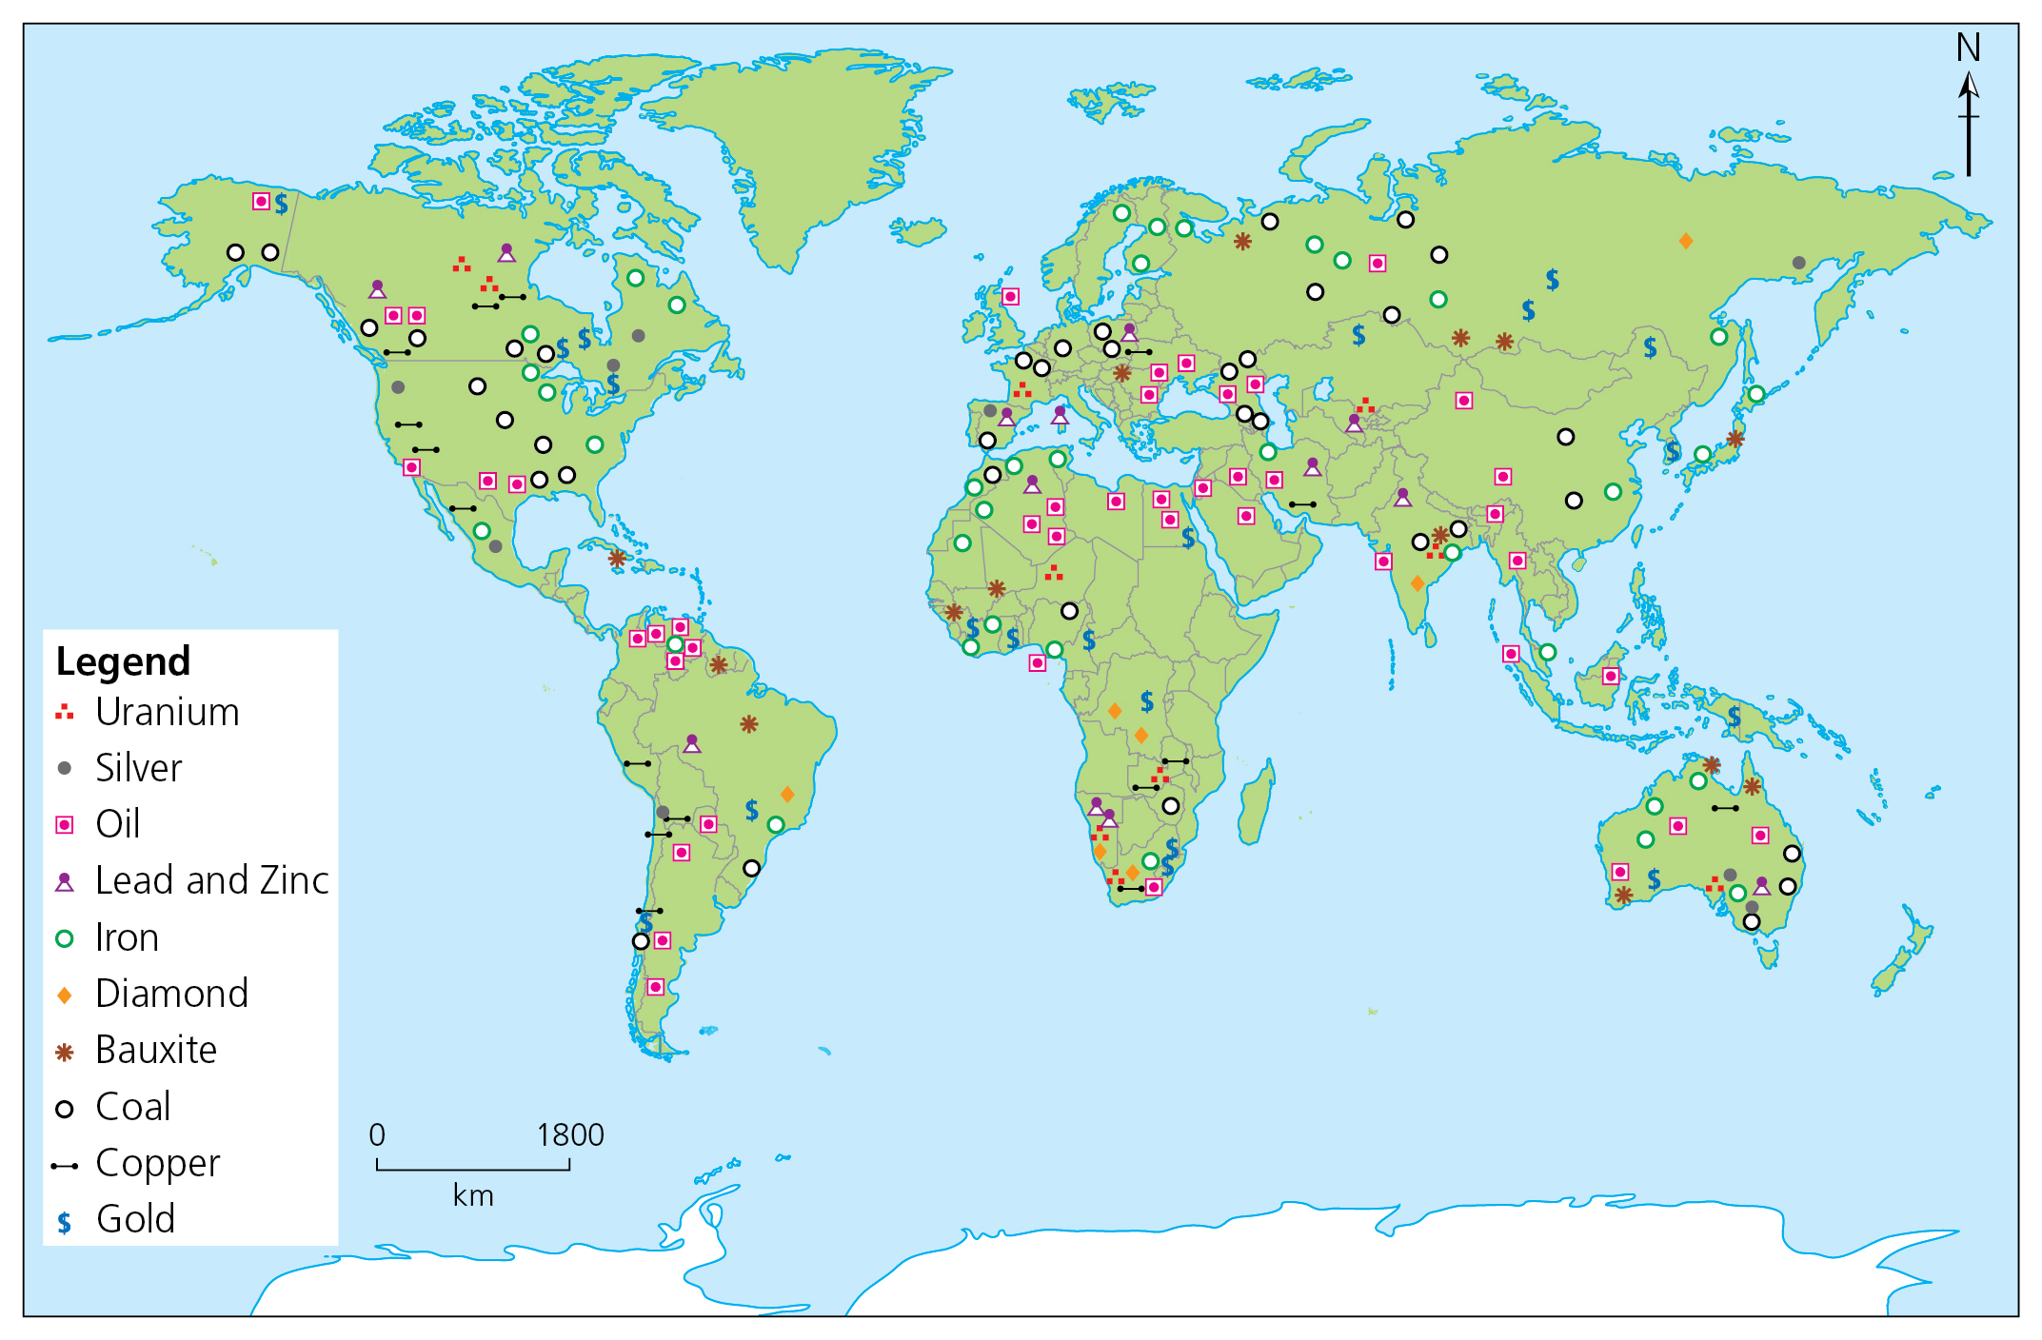
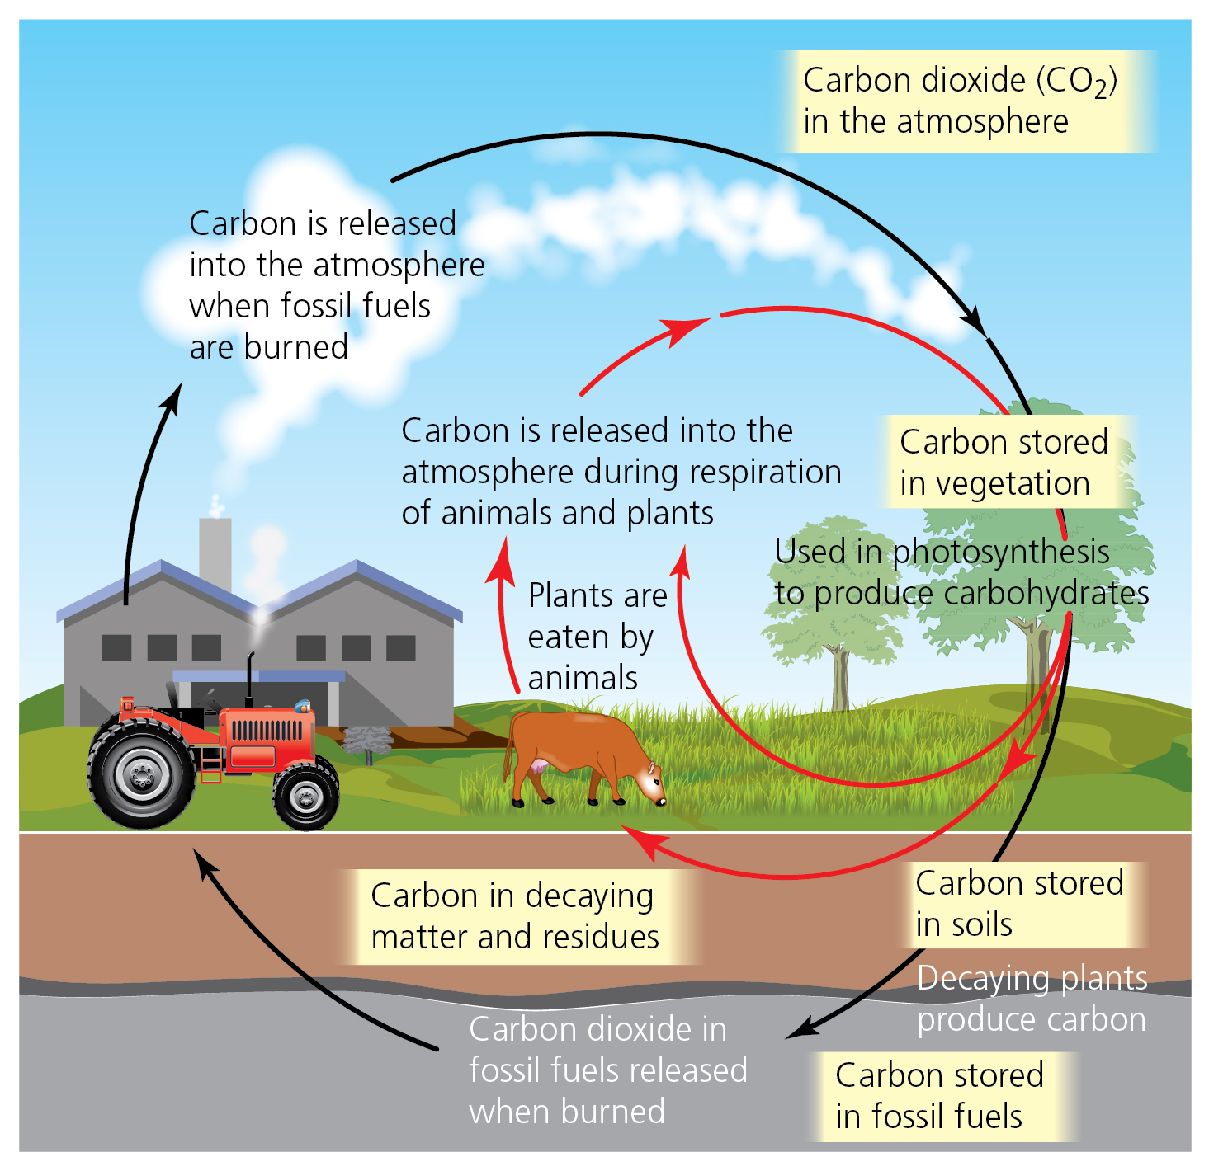
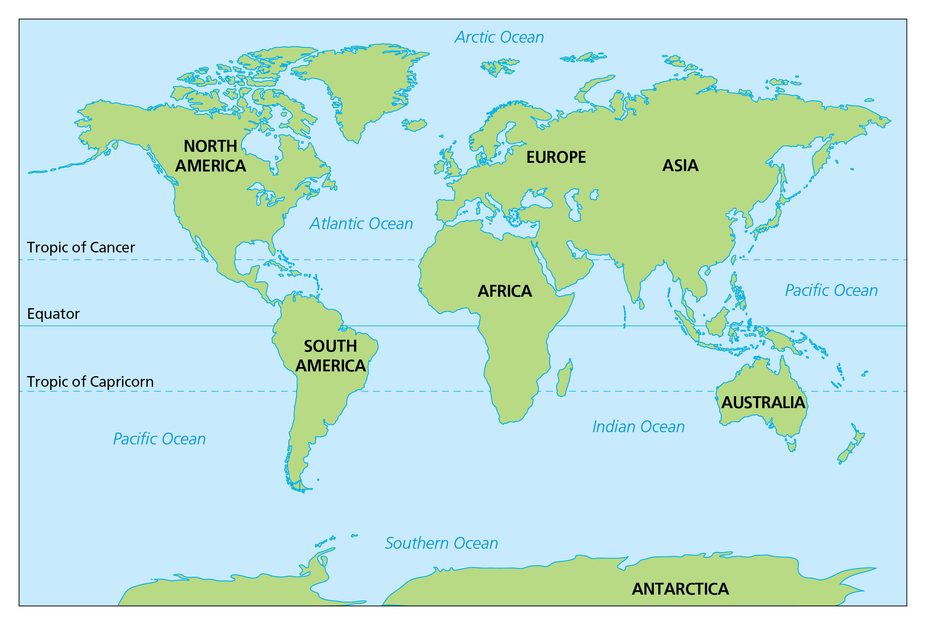
SUBJECT : Geography: Sustainability (Spring 1) YEAR: 6
Vocabulary
1 | Sustainability | The practice of using natural resources responsibly, so they can support both present and future generations.
2 | Mineral | Minerals are solid substances that occur naturally. They can be made up of a single element or a combination of elements. The Earth is made up of thousands of different minerals.
3 | Biomass | Organic material from plants and animals. This can be used to create energy.
4 | Geothermal energy | The heat that comes from inside the Earth.
5 | Biodiversity | The variety of all living things on Earth.
What Skills I Need To Know
To describe the key aspects of the distribution of natural resources including energy, minerals and water.
To use maps, atlases and globes to locate countries and describe features studied.
To use the eight points of a compass, symbols and keys to build knowledge of the UK and the wider world.
To use fieldwork to observe, measure, record and present human and physical features in the local area, using a range of methods including sketches, plans and graphs.
What Should I Already Know?
Use maps, atlases and globes to locate South America. Use up to eight points of a compass, symbols and keys when describing locations.
Key knowledge
To understand where our energy and natural resources come from.
To be able to explain some ways biomes (including the oceans) are valuable, why they are under threat and how they can be protected.
To be able to explain several threats to wildlife/habitats.

