Slide 1

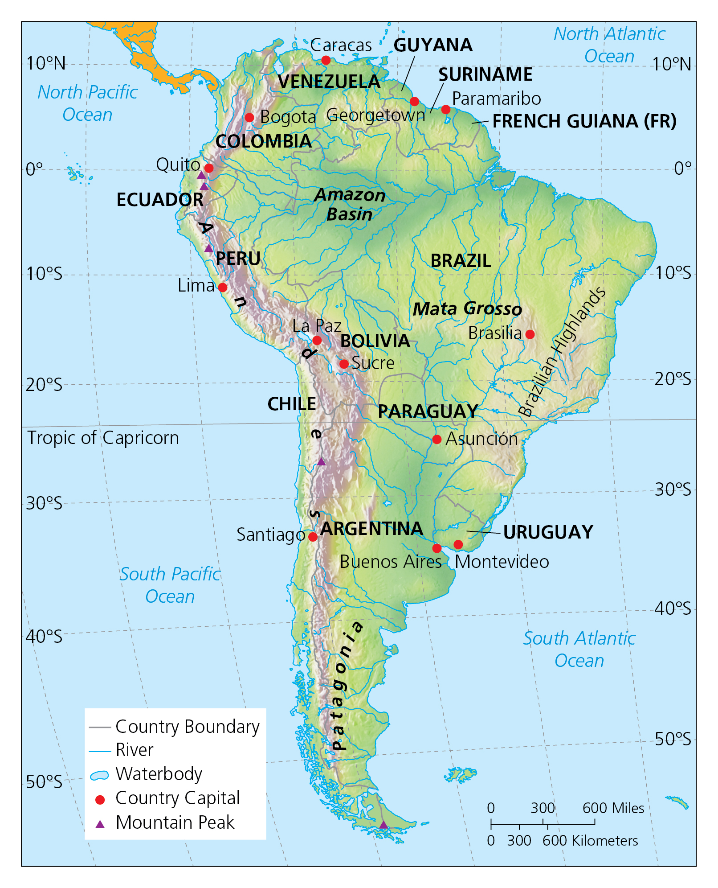
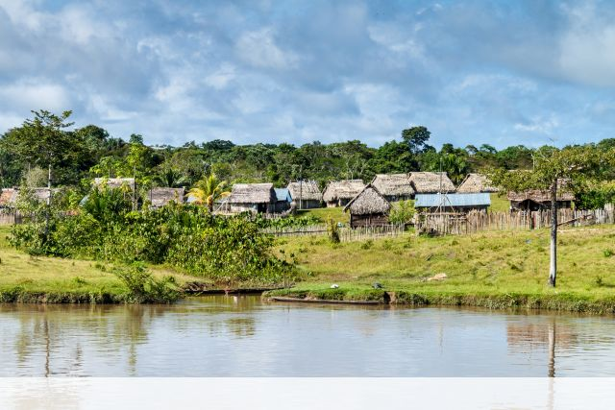
Geography: South America: The Amazon (Autumn 1) YEAR: 6
Vocabulary
1 | River basin | the area drained by the River Amazon and all of its tributaries
2 | Climate | weather patterns in a place over a long period, such as seasonal rainfall, sunshine and temperatures
3 | Human and Physical features | Human and physical features are things that you can see all around you. Physical features like seas, mountains and rivers are natural. They would be here even if there were no people around. Human features like houses, roads and bridges are things that have been built by people
4 | Settlement | A place where people live
5 | Deforestation | the purposeful clearing of forested land
6 | Shifting cultivation | An agricultural systems where plots of land are used temporarily. It consists of clearing a plot of land of the trees/plants, then burning. The ash is used to fertilise the land. After a few years, the land is abandoned, so its fertility can be naturally restored. The farmers move on to cultivate another plot of land.
Key Facts
1 | The Amazon is a vast region that spans across 9 countries: Brazil, Bolivia, Peru, Ecuador, Colombia, Venezuela. Guyana, Suriname and French Guiana.
2 | The Amazon River Basin is home to the largest rainforest in the world and covers almost 40% of South America. The Amazon River is the second longest river in the world. It has the largest drainage basin in the world.
3 | Weather is the given conditions on a particular day, climate refers to average weather patterns in a place.
4 | The Amazon has a tropical climate. There are two seasons: wet and dry.
5 | The region is most renowned for its rainforest, which covers most of the Amazon basin. 60% is in Brazil. The Amazon represents over half of the planet’s remaining rainforests.
6 | The Amazon is home to more than 30 million people and about 9% is still made up of indigenous people.
7 | The Meeting of Waters is the confluence between the Rio Negro, a river with dark water, and the sandy coloured Rio Solimoes, which run side by side without mixing for 6km. This is due to differences in temperature, speed and water density of the two rivers.
8 | Deforestation has been linked to reduced rainfall.
What should I already know?
The difference between human and physical geography.
The location of different continents, including South America.

Slide 2
Geography: South America: The Amazon (Autumn 1) YEAR: 6
What I need to know
1 | To locate cities, countries and regions of South America on physical and political maps.
2 | To describe key physical and human characteristics and environmental regions of South America.
3 | To understand how climate and vegetation are connected in biomes e.g. the tropical rainforest.
4 | To describe what the climate of a region is like and how plants and animals are adapted to it.
5 | To know and understand what life is like in cities and in villages and in a range of settlement sizes.
6 | To explain some ways biomes (including the oceans) are valuable, why they are under threat, and how they can be protected.
7 | To understand how human activity is influenced by climate and weather.
8 | To explain several threats to wildlife/habitats.

